Slide 1
Philosophy and Foundation of Christian Education

Slide 2

Dari seorang Kristen yang mengajar menjadi seorang guru Kristen
Notes:
2
MY UNEXPECTED PLACE
God called me to be a “missionary teacher” in August 1968 in a farm house in rural Saskatchewan and I’ve spent almost 40 years finding out more about what that means.
Personal experience
I'd like to share with you some of my journey from being a Christian who teaches to a Christian teacher. The journey began in state schools. About half of my school experience has been in state schools and half in Christian schools. I was a student most of the time in state schools and a teacher most of the time in Christian schools, but my experience on both sides of the teacher's desk has certainly impacted my expectations and conduct as a teacher.
As a student I only know 2 teachers who were Christians.
My elementary school principal – Mr Wilson
I knew he was a Christian because my parents told me was. They knew him from a church in another part of the city where he was active. I didn't want to spend any more time that necessary with him and felt fortunate that I spent little time with him in his office.
My ISCF sponsor in my junior high school (age 14-16) – Miss Phare
She was an influential person as I went through some very difficult adjustments as a young teen but I didn't have her for any classes. I knew her as part of extra-curricular activities that were meaningful and enjoyable, but not as part of my learning experience.
I never had the opportunity to experience having my knowledge and understanding of a subject shaped by a Christian teacher – except in Bible college and my graduate studies at a Christian university.
How many have heard of the book, "Everything I need to know I learned in kindergarten" by Robert Fulgham? The somewhat sentimental ideas about being nice and fair are important, but I learned them in Sunday School, not kindergarten. What I learned about all the important subjects that I was introduced to in school - science, mathematics, literature, history, economics, sociology, music, art, etc. - was presented from a godless perspective.
I had some excellent teachers to whom I will always be indebted and none of them had an anti-god perspective. BUT it never occurred to me that being a Christian might affect my teaching.
I loved science but after messing up my first year of university and falling for a girl who was headed to Bible college, I decided to do the good Christian thing of giving God a year to study the Bible and allow Him to tell me what to do. During that time I never heard anything that I can remember about how science related to anything that God was interested in. Preachers, evangelists, youth workers, camp workers, children’s club workers (full or part-time clergy) – those were Godly vocations. Being a scientist was not.
God really got my attention when He called me to be a “missionary teacher” – missionary I knew from church and I had a lot of experience with teachers. I’d speculated long ago that I could do better than some of them.

Slide 3
Tahap-tahap perjalanan
Ketidaktahuan
Tidak setuju
Keingintahuan
Membaca
Diskusi
Eksperimen
Sintesa
Seminar
Notes:
3
How many of you went to a Christian elementary school? Secondary school? University? Bible college or seminary?
I attended public schools in BC until I went to Bible school.
I only know of two Christian teachers
Elementary principal, Mr. Wilson – I tried to avoid spending time with him
Junior high ISCF sponsor, Miss Phare – never had her for a class
I had many good, even great teachers, but it never occurred to me to think of how being a Christian might affect my teaching
******************
Ignorance
My degree in Religious education didn’t make me think about anything other than church education
Even my call to be a missionary teacher didn’t cause me to consider the possibility that I would approach teaching differently because I was a Christian. God knew that I’d be confused if He wasn’t very specific so He spoke very clearly to me through a radio broadcast that I heard on a farm in SK in August 1968. I am still discovering what being a missionary teacher involves, but I’ve been sure that God wanted me to be one for almost 40 years!
I can still remember in my early 20’s when I finally realized that the Bible had something to say about everything – including haircuts and speeding tickets.
*******************
Dissonance
My teacher training at SFU began a period of dissonance.
Classroom discipline – students aren’t naturally good; it isn’t always the environment - and the teacher as part of the environment - that is responsible for all student problems.
Creation science conference that gave me some basic principles that gave scientific support to my long-held belief in God’s creation
Teaching in SK – introduced multiple options regarding the origin of the world and the beginning of human history – got a private word with the head of the school board about the embarrassment I was causing the biology teacher who was also the school principal
Conclusion: the system is the problem
***********************
Curiosity
When I arrived at BFA – a school for missionary children – I didn’t know how to teach any differently than I’d been prepared by experience and instruction. I was a godless teacher even though I was a Christian. I’d never been in a school like it before and had never even heard of Christian schools. Although all the staff were Christians, the school didn’t identify itself as Christian. It just served Christians and anyone else who wanted to send their children to be “fixed.”
Our dorm assistant and elementary PE teacher, Myra Gannett, came from a “real” Christian school in the USA and she introduced some things like a “philosophy of Christian education” that they had where she used to teach. This was interesting! We had a staff meeting and agreed that we would adopt virtually the same statement for BFA. We hadn’t thought much about the why or how, but the idea of being a “Christian” school sounded good.
******************
Reading
We got connected with ACSI and discovered that people had written a lot about what it meant to be a Christian school and a Christian teacher. I read everything I could get a hold of which wasn’t so very much in Germany in the late 70’s and early 80’s.
Frank Gaebelein, The pattern of God’s truth: The integration of faith and learning
Albert Greene, Reclaiming the future of Christian education: A transforming vision
********************
Discussion
I had the privilege, as high school principal, of spending a lot of time with our school director, Henry Toews. I was late for supper too many nights when we got going about the implications of being Christian in some aspect of school life. We didn’t include many others in the discussions since most of them had already gone home, but we explored all areas of administration, science teaching, etc. The ideas that we were reading became our own as we introduced them to each other and argued through the implications.
*********************
Experimentation
Was my classroom any different as the result of what was going on in my head? Well, neither of us had seen any of this in practise so we just made things up as we went along. I tried to be Christian in the way I taught, but I didn’t really know how. I had complete freedom to do anything Christian that I wanted and was, in fact, encouraged to do everything that I could, but I didn’t do very much differently. Many classes were still godless although we occasionally had some great discussions about the implications of what we were teaching/learning. Sometimes the students thought they were getting me off on a rabbit trail and sometimes I felt like we were missing the “real content” as well.
I discovered that without specific help I was simply a Christian who taught rather than a Christian teacher. My being a Christian really made very little difference to what I did in the classroom other than motivating me to be “nice” and “fair”. My good intentions, my interest in the subject, my reading and discussion, didn’t translate into transformed teaching. Like a friend in Japan, Michael Essenburg says, there was a tremendous rhetoric/reality gap!
********************
Synthesis
How did things change so that I am now passionately involved in trying to communicate what God has been teaching me about how to approach education in such a way that it is Christian by nature and not only by name?
I was asked to tell others about Christian education.
When I was caught in the steam-roller of the school schedule and curriculum, it was far easier to continue doing what came automatically – the godless teaching patterns I’d observed since my childhood – than trying to connect the ideas in my head with my practise in the classroom.
During the mid-80’s teachers from around Europe were invited to come to BFA during the summer to talk about what it meant to be a Christian teacher. I was often involved more in the logistics as one of the hosts, than the presentations, but some ideas began to take at least nebulous shape.
When the Ceausescu communist regime fell in Romania, the church had started Christian schools. They knew that the communist schools had promoted atheism and systematically excluded Christians from higher education. They wanted to teach their children and young people to be Christians, not communists, so they quickly established pre-schools and high schools. Then they began asking what it meant to be a Christian school. How should teachers who had survived the communist system teach differently in a Christian school? What should they teach? If the government controlled the required curriculum and final exams, how could their schools be Christian? ACSI went in to help and in 1991 they held their first teacher’s conference for Christian teachers. Our whole family went with our sons recording and duplicating the sessions and myself leading sessions. BFA was 35 years old so we were expected to be able to provide answers to the huge number of questions that the Romanians had. I don’t think they realized at first, how much it was a case of the blind leading the blind or maybe better one beggar telling another where to find bread.
***********************
Teaching
The synthesis and teaching have gone hand in hand as I’ve had unusual, unexpected opportunities to share what God has been teaching me from Eastern and Western Europe to Asia to N. America, and today to this place.
I appreciate the opportunity to share with you some of the things that God has been teaching me in the past 56 years and especially in the last 29 years since I got involved in a Christian school. I hope to save you some of the time that I lost through ignorance and help you on your journey by relating some of the things that I’ve seen along the way.
************************
Where are you on your journey? Have you become aware of the distance between where most people find themselves now and where they will be when Christ completes His work in their lives? How is your classroom different than the one down the hall? If they asked, could you articulate to your students and peers what it means to have the “mind of Christ” about the subjects that you teach? What is keeping you from becoming the Christian teacher God called you to be?

Slide 4


Slide 5
What is your situation?
What makes your school a Christian school?
What makes your classroom Christian?
How do you teach differently because you are in a Christian school?
What do you teach that is different in a Christian school?

Slide 6
Pertanyaan2
Apakah pendidikan itu?
Di manakah Kristus dalam pendidikan?
Di manakah Alkitab dalam pendidikan?
Perubahan kekal apa yang Anda telah lakukan di kelas Anda?

Slide 7
Christ-in education defined
Education is …
The process of preparing a person for life
Christ-in education is …
The process of preparing a person for life in which all elements including the teacher, student, content, methodology, philosophy, objectives, assessment, environment, etc. are related to Christ and are being transformed by Him

Slide 8

LEGALISM

PRIDE
TRAINING
INSTRUCTION
(BEHAVIOUR)
(KNOWLEDGE)
P
HOLY SPIRIT
G
O

N
W
I
D
E
N
R
A
T
S
Image of God
R
Image of God
E
D
N
U
L
E
V
0
NURTURE
(RELATIONSHIP)
SELFISHNESS
Education
Transform-Ed

Slide 9
3 Dimensi Pengajaran
Siapa
Bagaimana
Apa
Notes:
9
The Truth must permeate every part of the education process.
If the teacher is not transformed by Truth – the living Word of God, the Bible, and the Word, Jesus Christ Himself – he will tend to push people away from Christ rather than draw them toward Him. Nothing else works if this is missing. The truth must be integrated into the life of the teacher, transforming his or her thinking, feeling and behaving, before he or she can be used to transform the lives of students – parable of the sawdust and the plank (Matt 7:3-5, Luke 6:41-42).
I’m not going to address this part because it is addressed in every message, every Sunday School class, every tape, and every book and is relevant for every Christian whether they are a teacher or not. It is not that we have put everything into practise, but I want to focus on things are more exclusively related to education.
Because there is often great concern about what can or cannot be said in a public school – and public schools are where most of us have been trained and gotten our experience – many Christians focus on how to be a Christian in the classroom by considering their approach or methodology. Sometimes it doesn’t get much beyond being nice and being moral, but it is a start at considering what it means to having education which is Christian by nature and not just by name.
There is an interesting article by Donald Oppewal, Biblical Knowing and Teaching, a Calvin College Monograph, 1985 which addresses more of this question that I’d recommend for your reading enjoyment. I’d summarize the focus of this aspect of Christian education as being on relationships: teacher-student, student-teacher, student-student, teacher-teacher, teacher-administration, administration-teacher, teacher-parent, parent-teacher, parent-student, student-parent.
This is also critically important. There is a sense in which a teacher’s relationship to God and His Word will naturally transform their relationships with everyone else, but unless teachers consciously consider this aspect of Christian education it is likely they will be “like their teachers” (Luke 6:40) and operate in god-less or un-godly ways. After all, Rom. 12:2 says we are “transformed by the renewing of our mind” so if we don’t engage our minds, it is unlikely much transformation will take place.
It is the third aspect of Christian education that I believe from my own experience, is the least transformed. There are many reasons:
Most Christians have been trained by non-Christians
Most Christians have taught in situations where introducing Christ in the classroom was highly restricted
Most Christians operate as functional dualists with God and His Word only being relevant to “spiritual” things and not physical things.

Slide 10
Dimensi mana yang paling penting?
Atas & bawah?
Depan & belakang?
Kanan & kiri?
1D – garis
Tidak terlihat
2D – datar
Dapat dilihat, tidak dapat dirasakan
3D – volume
Notes:
10
2D – can’t get into it
Trinitarian application – Father can’t be seen, Christ made God visible, but only the Holy Spirit can make eternal life a reality
You can look at Jesus and say – “now I know what God’s like” → I’m going to live a godly life – impossible without the divine power of the indwelling Holy Spirit
Ambassador’s representing Christ → reconciled to God
God is invisible – all know that
Only way people can see God is through the lives of God’s people – we represent Christ, grow into His image, book known and read of all men
Not enough – can’t live a book – need the Holy Spirit; isn’t it great that the Holy Spirit is everywhere that God’s people are! Don’t have to worry about getting caught without the Holy Spirit.

Slide 11
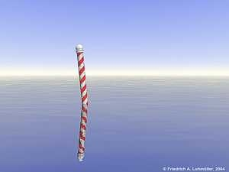
Siapa?
Notes:
11

Slide 12
Sepeda roda satu, roda dua, dan roda tiga
Notes:
12
The personal integration of truth into a teacher's life is essential. It is like a wheel with pedals that the Holy Spirit uses to propel the person. However, unicycle's are very unstable and almost useless for travel. When you add a second wheel (either method or content) you have a bicycle which is extremely functional. You can go long distances at high speeds, but you can't take very much with you - more than on a monocycle but still restricted. When you have all three present - a tricycle - you still need the wheel with the pedals or the whole thing goes nowhere, but now you can take huge quantities with you. China was full of 3-wheelers used for all kinds of purposes. My experience has been that the personal integration of truth is the area that has best been developed for it is really common to all Christians. If their spiritual life is to "go somewhere" they need to be personally transformed and virtually all messages, seminars, etc. focus on this. The area of approach seems to be the next to be considered, but all too often a Christian approach seems to boil down to being nice and moral - totally insufficient, although better than being mean and immoral. Because of the restrictions and even hostility encountered by Christians in state schools, many have assumed that nothing can be done about the content so that approach/method is the only possible area to be impacted beyond a teacher's personal life. I think that the idea of critical questions could be developed by Christian teachers in virtually any situation to help students analyze the great variety of input into their lives from media, textbooks, entertainment, etc. Knowing where various input is coming from and going to would allow them to make real decisions about their personal lives. In the process the Christian teacher would almost inevitably have opportunities to share their personal perspective in response to questions as well as keep the enemy from blinding students to the consequences of common kinds of "thinking."

Slide 13
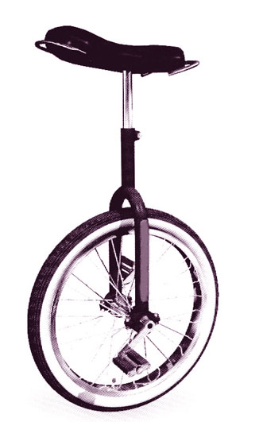
Notes:
13

Slide 14
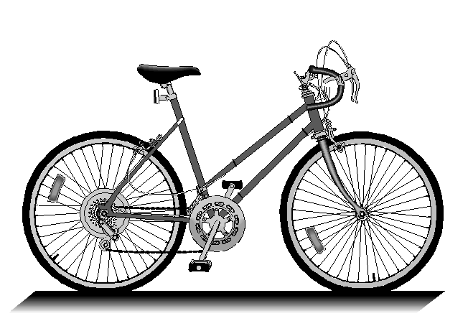
Notes:
14
The evolution of the bicycle is a typical example of the technological evolution. The first bikes were cobbled together from pieces of horse-drawn wagons. As the designer also became the motor or draft animal, efforts to reduce weight, improve control, safety and efficiency were stimulated. Ultimately, in less than 200 years the bicycle and rider on a paved road have become the single most efficient land vehicle (greatest distance traveled per weight per unit of energy expended) of any and all land traveling vehicles or animals. When the overall economics are considered, travelling by bicycle is cheaper than walking!

Slide 15
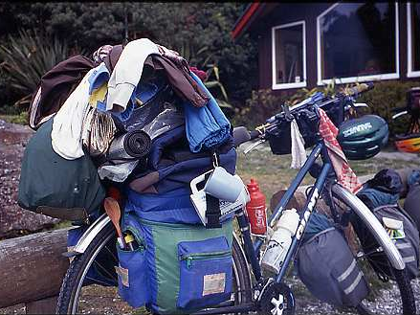
Notes:
15

Slide 16

Notes:
16

Slide 17
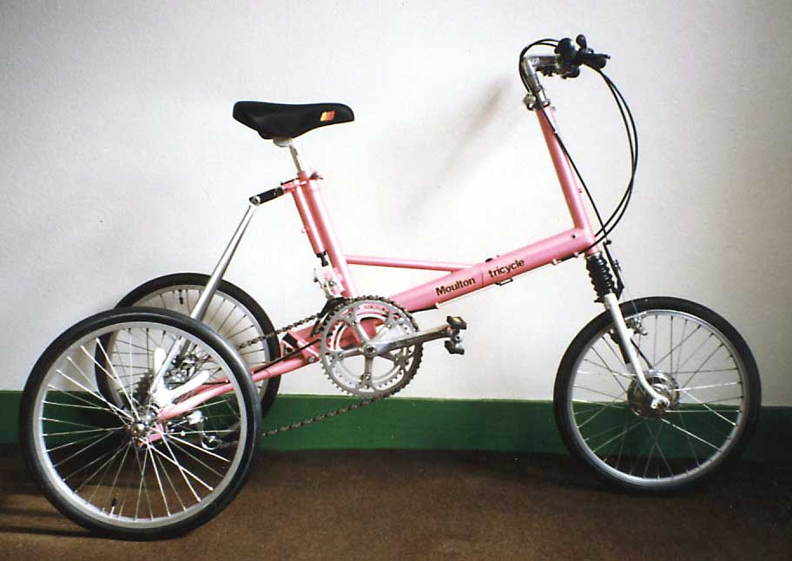
Notes:
17

Slide 18
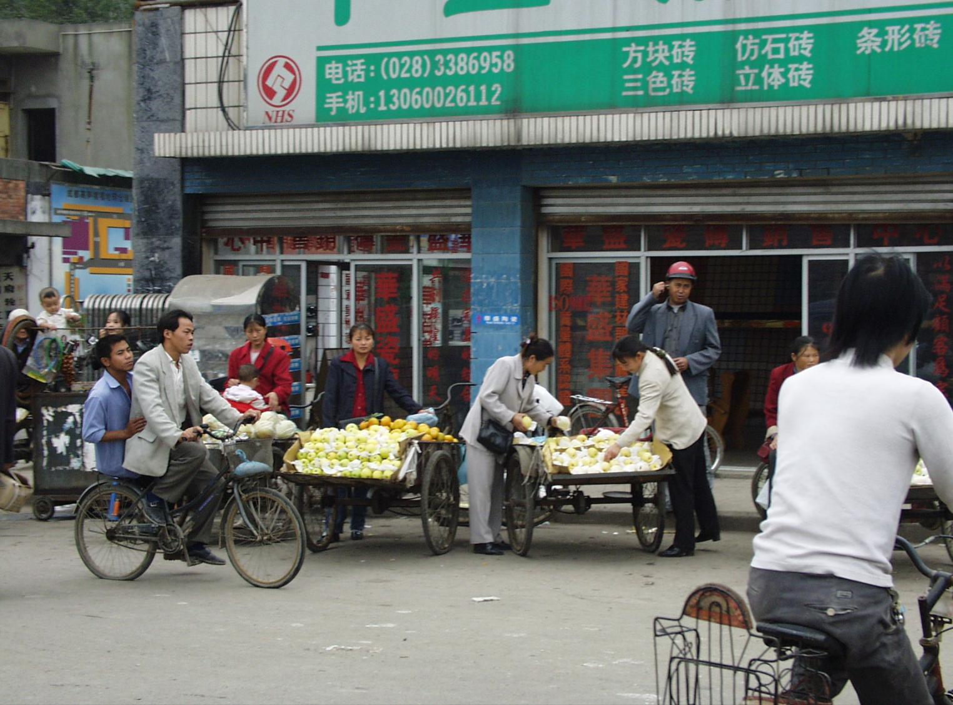
Notes:
18

Slide 19
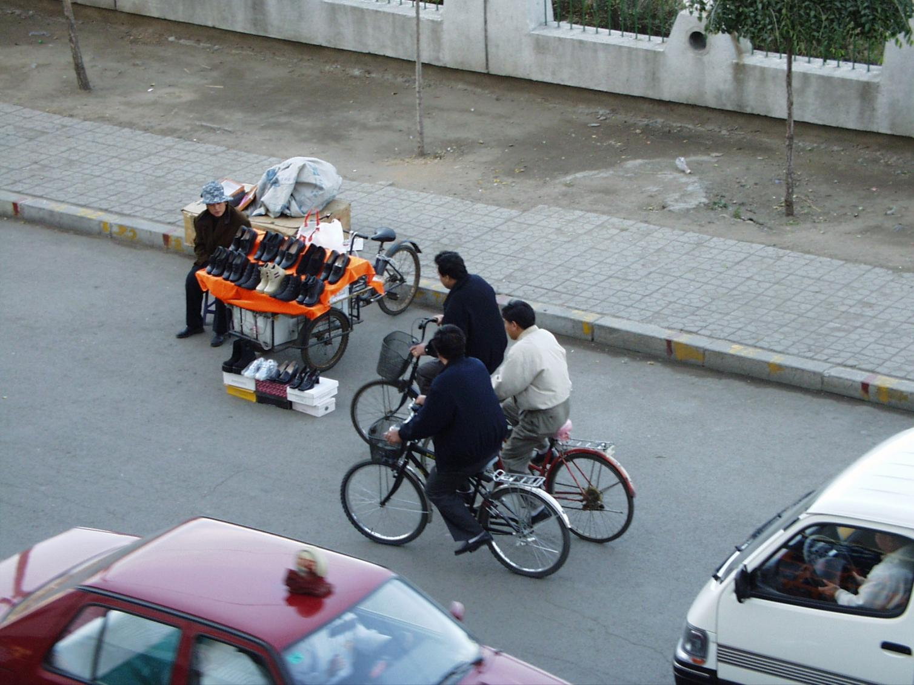
Notes:
19

Slide 20
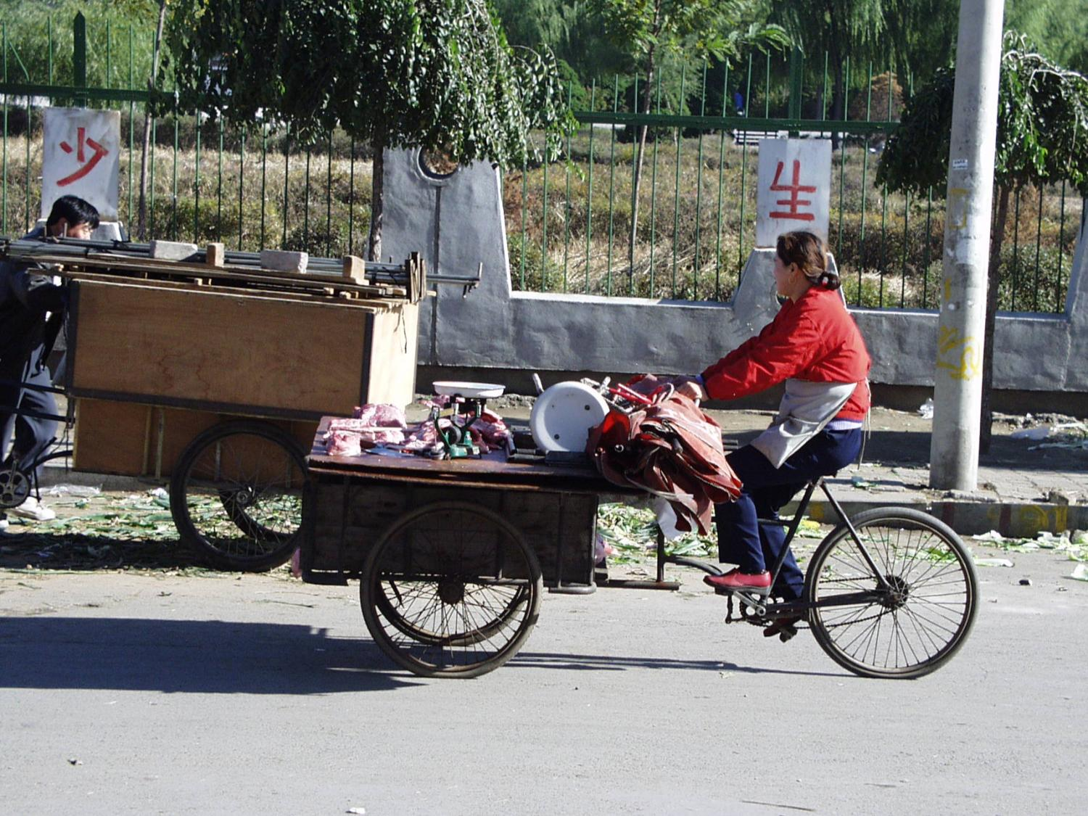
Notes:
20

Slide 21
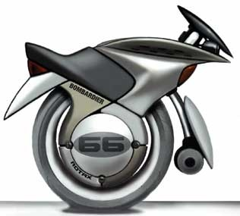

Slide 22
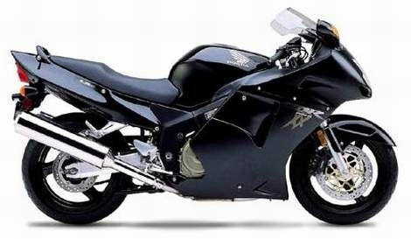

Slide 23
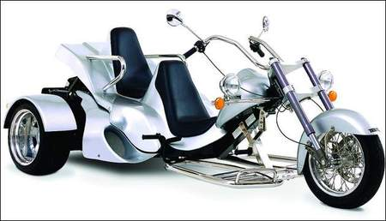

Slide 24
3 Dimensi Pembelajaran
Pengetahuan
Hikmat
Pemahaman
Notes:
24
The Truth must permeate every part of the education process.
If the teacher is not transformed by Truth – the living Word of God, the Bible, and the Word, Jesus Christ Himself – he will tend to push people away from Christ rather than draw them toward Him. Nothing else works if this is missing. The truth must be integrated into the life of the teacher, transforming his or her thinking, feeling and behaving, before he or she can be used to transform the lives of students – parable of the sawdust and the plank (Matt 7:3-5, Luke 6:41-42).
I’m not going to address this part because it is addressed in every message, every Sunday School class, every tape, and every book and is relevant for every Christian whether they are a teacher or not. It is not that we have put everything into practise, but I want to focus on things are more exclusively related to education.
Because there is often great concern about what can or cannot be said in a public school – and public schools are where most of us have been trained and gotten our experience – many Christians focus on how to be a Christian in the classroom by considering their approach or methodology. Sometimes it doesn’t get much beyond being nice and being moral, but it is a start at considering what it means to having education which is Christian by nature and not just by name.
There is an interesting article by Donald Oppewal, Biblical Knowing and Teaching, a Calvin College Monograph, 1985 which addresses more of this question that I’d recommend for your reading enjoyment. I’d summarize the focus of this aspect of Christian education as being on relationships: teacher-student, student-teacher, student-student, teacher-teacher, teacher-administration, administration-teacher, teacher-parent, parent-teacher, parent-student, student-parent.
This is also critically important. There is a sense in which a teacher’s relationship to God and His Word will naturally transform their relationships with everyone else, but unless teachers consciously consider this aspect of Christian education it is likely they will be “like their teachers” (Luke 6:40) and operate in god-less or un-godly ways. After all, Rom. 12:2 says we are “transformed by the renewing of our mind” so if we don’t engage our minds, it is unlikely much transformation will take place.
It is the third aspect of Christian education that I believe from my own experience, is the least transformed. There are many reasons:
Most Christians have been trained by non-Christians
Most Christians have taught in situations where introducing Christ in the classroom was highly restricted
Most Christians operate as functional dualists with God and His Word only being relevant to “spiritual” things and not physical things.

Slide 25

Valet Visual
© Harold Klassen 2003
© Harold Klassen 2003
Notes:
25

Slide 26
Apakah Pendidikan Itu?
Dalam 2 menit jawablah pertanyaan Apakah Pendidikan Itu?
Diskusikan jawaban Anda dengan rekan di sebelah Anda
Siapkan definisi pendidikan bersama-sama
Notes:
Before we can talk about Christian education we need to talk about education itself.
You’re all teachers. You’re all involved in education. Can you succinctly say what you’re doing?

Slide 27
Apakah Pendidikan Itu?
Pendidikan adalah proses mempersiapkan manusia bagi kehidupan
  Kehidupan bukan pekerjaan
Notes:
This is the definition I developed for my Philosophy of Christian Education paper.
What kind of perspective on life are we communicating?
The idea that education should make good citizens and prepare people for a good job is widespread. Why are so many people all over the world interested in learning English? Because they think that it is a ticket to greater economic opportunity for themselves and their families.

Slide 28
Hidup dari sudut pandang seorang anak
Kemarin
Hari ini
Besok

Slide 29
Hidup dari sudut pandang seorang remaja
Tahun lalu
Tahun ini
Tahun depan

Slide 30
Hidup dari sudut pandang seorang murid
Sekolah Dasar
Sekolah Menengah
Universitas

Slide 31
Hidup dari sudut pandang seorang lulusan universitas
SMA
Universitas
Karir

Slide 32
Hidup dari sudut pandang seorang dewasa
Pendidikan
Karir
Pensiun

Slide 33
Hidup dari sudut pandang seorang manula
Karir
Pensiun
Kematian
Notes:
Seniors get younger all the time. The world’s mold is very strong. “Everyone” talks about and plans for retirement—the time to enjoy life. You try to get through your career as quickly as possible so that you can have maximum time to do what you want instead of what someone else wants. However, such a perspective is very definitely short-sighted.
What is the average time that people in your country live? → Everyone you have ever met will live forever either in God’s presence or separated from Him.

Slide 34
Hidup dari sudut pandang seorang Kristen
Pendidikan
Hidup Kekal
Notes:
Our “three-score and ten” years are merely the briefest of introductions to life.
Life begins at conception and continues forever! Physical birth changes the environment of life. Spiritual birth ends spiritual death and begins eternal life. Physical death ends all opportunities to change our spiritual condition but it doesn’t end our existence.
Any process of education that conforms with reality must deal with the fact that we are not planning for the short-term, but for eternity. We think that someone who has developed a 5-year plan is a long-range planner, but everyone has to have a 100-year plan. Every teacher needs a personal 100-year plan and so do our students. Anything less is inadequate to deal with all the circumstances that we will encounter in this critical, direction-determining part of our life.
All that we learn and do is “meaningless” unless we have an eternal perspective of life.
What is your 100 year plan? Change in us and change in others through us?
What do you expect God to do in your life in the next 100 years?
What do you expect Him to do in the lives of others?

Slide 35
Akar keputusasaan
Pengkhotbah 3:17-21
Karena nasib manusia adalah sama dengan nasib binatang, nasib yang sama menimpa mereka; sebagaimana yang satu mati, demikian juga yang lain. Kedua-duanya mempunyai nafas yang sama, dan manusia tak mempunyai kelebihan atas binatang, karena segala sesuatu adalah sia-sia. Kedua-duanya menuju satu tempat; kedua-duanya terjadi dari debu dan kedua-duanya kembali kepada debu.

Slide 36
Akar keputusasaan
Pengkhotbah 3:17-21
Siapakah yang mengetahui, apakah nafas manusia naik ke atas dan nafas binatang turun ke bawah bumi.

Slide 37
Bagaimana kita mengembangkan perspektif Alkitabiah?
Tuliskan paling sedikit dua cara mengembangkan perpektif Alkitabiah dalam 1 menit.
Ceritakan jawaban Anda pada paling sedikit dua orang lain dan gabungkan pendapat Anda.

Slide 38
Bagaimana kita mengembangkan perspektif Alkitabiah?
Bicaralah mengenai surga—dan neraka
Evaluasi efek jangka panjang dari pilihan
Bicaralah mengenai orang yang telah meninggal
Bicaralah mengenai hal-hal spiritual, tidak hanya yang material
Gunakan diagram sebagai pengingat visual

Slide 39
Apakah Pendidikan Itu?
Pendidikan adalah proses mempersiapkan manusia bagi kehidupan
  Hidup bukan pekerjaan
  Manusia bukan program
Notes:
Teaching is a person-to-person activity.
I have a great deal of personal scepticism about all the propaganda promoting computers to do teaching. There is definitely a kernel of truth because computers depend on people for their existence and every program that controls them is created by a person. Often, however, the person creating a program is not evaluated because they are unknown and the relationship between their perspective of life and the program they produce is not even considered.
No one ever promoted that pencils would be able to teach students mathematics but sometimes the complexity of modern technology makes people forget that computers are simply more powerful tools in the hands of a teacher.
Every student is a unique expression of God’s creativity and reflection of some aspect of His character even though sin has distorted the good things that God has created for His glory. Unique people need unique preparation to be all that God intends them to be by His grace.

Slide 40
Orang-orang yang terlibat dalam pendidikan
Orang-orang yang menyiapkan
Orang-orang yang disiapkan
Notes:
Both are necessary but roles may be formal or informal, rigid or shifting.
Usually the one doing the preparing is designated “teacher” while the one being prepared is “the student,” however, each student is preparing the teacher for the next student and the next class, so the roles get somewhat blurred.
Both participants must be active in the process of education, but there is a definite burden of responsibility on the one who is doing the preparing.

Slide 41
Tanggung jawab guru
Yakobus 3:1-2
Saudara-saudaraku, janganlah banyak orang di antara kamu mau menjadi guru; sebab kita tahu, bahwa sebagai guru kita akan dihakimi menurut ukuran yang lebih berat. Sebab kita semua bersalah dalam banyak hal; barangsiapa tidak bersalah dalam perkataannya, ia adalah orang sempurna, yang dapat juga mengendalikan seluruh tubuhnya.
Notes:
Watch what you say because your students—and God—are listening.

Slide 42
Tanggung jawab guru
1 Yohanes 2:28
Maka sekarang, anak-anakku, tinggallah di dalam Kristus, supaya apabila Ia menyatakan diri-Nya, kita beroleh keberanian percaya dan tidak usah malu terhadap Dia pada hari kedatangan-Nya.
Notes:
John knew that he would be evaluated on the basis of how his “children,” his disciples, performed.

Slide 43
Apakah Pendidikan Itu?
Pendidikan adalah proses mempersiapkan manusia bagi kehidupan
  Hidup bukan pekerjaan
  Manusia bukan program
  Persiapan bukan latihan
  Proses bukan produk
Notes:
The individual has ultimate responsibility for the choices that they make in life. Although the teacher has the solemn responsibility to prepare each child well—and the younger the student the more responsibility—the person cannot blame his preparation or lack of it for his personal decisions.
Matthew 18:6
But if anyone causes one of these little ones who believe in me to sin, it would be better for him to have a large millstone hung around his neck and to be drowned in the depths of the sea.
Even a perfect environment, perfect parents, and a perfect Teacher don’t guarantee success – ask Adam.
It is grammatically correct to say that a person receives an education, but an education isn’t something that you can buy at the store like new clothes or a new house – more appropriate price range.

Slide 44
Apakah Pendidikan Kristen itu?
Dalam 2 menit responilah kutipan di handout Christian Education Perspectives
Diskusikan jawaban Anda dengan orang di sebelah Anda
Siapkan bersama definisi pendidikan Kristen
Notes:
Before we can talk about Christian education we need to talk about education itself.
You’re all teachers. You’re all involved in education. Can you succinctly say what you’re doing?

Slide 45
Pendidikan Kristen didenifisikan
Pendidikan adalah …
Proses mempersiapkan manusia bagi kehidupan
Pendidikan Kristen adalah …
Proses mempersiapkan manusia bagi kehidupan di mana semua elemen terkait dengan Kristus dan diubahkan oleh-Nya
Notes:
Christian education is defined in many ways
Education by Christians does not guarantee education which is Christian
Education of Christians does not guarantee education which is Christian
Christ-centred education
Correct perspective
Not a cliché
Purpose of a Christian school
Avoids problems of “Christian education”

Slide 46
Apa yang membentuk pendidikan Kristen?
Guru harus seorang Kristen
Murid harus seorang Kristen
1 Korintus 2:14
Tetapi manusia duniawi tidak menerima apa yang berasal dari Roh Allah, karena hal itu baginya adalah suatu kebodohan; dan ia tidak dapat memahaminya, sebab hal itu hanya dapat dinilai secara rohani.
Notes:
I want to distinguish here between Christian schools and Christian education. I believe that there has been a lot of confusion because people believe that everything that a Christian teacher does is Christian education and certainly everything that happens in a Christian school is Christian education. I don’t believe that either of these ideas are true.
Christian schools need to know what they are offering because everything isn’t evangelism or Christian education; there is a mixture. However, if we don’t recognize the difference we will have the wrong goals for our activities, be ineffective in what we do, be unable to evaluate our activity and be frustrated by the lack of results. Evangelism is pre-Christian education. It is necessary, but not the same thing as Christian education.
I trust that this is not a problem here although one of the missionaries that BFCF supports became a Christian while teaching at BFA. Nina Stephenson had grown up in a Christian home and been involved in all kinds of “Christian” activities, but hadn’t personally come to know Christ as her Saviour and Lord.
Finding Christian teachers for Christian schools is a major problem in Eastern Europe. A Christian school may employ non-Christian teachers, but at least in their classrooms, the students aren’t receiving a Christian education.
1 John 4:1
Dear friends, do not believe every spirit, but test the spirits to see whether they are from God, because many false prophets have gone out into the world.
Acts 17:11
Now the Bereans were of more noble character than the Thessalonians, for they received the message with great eagerness and examined the Scriptures every day to see if what Paul said was true.
Galatians 1:8
But even if we or an angel from heaven should preach a gospel other than the one we preached to you, let him be eternally condemned!
God can keep the blight of a godless teacher from defiling His children as He did in the case of Daniel and his three friends, but such a situation is not to be considered normal. Indeed, none of the other Hebrew students survived their training with their concept of a holy, jealous God intact.
Even in the case of Moses, God spent 40 years getting Moses to the place where He could use him after 40 years of the best in Egyptian education.
Christian teachers are necessary, but not sufficient for Christian education. Christians in a school don’t make a school Christian.
Becoming a Christian is the first step in the process of becoming all that God intends us to be – His child, His body, His temple. Unless the teacher understands God’s ultimate intention for himself and his students, it is unlikely that he will be very effective in God’s transforming purpose. If he’s not being changed, he can’t be a good model and if he doesn’t know the goal, he can’t help others reach it either.
Luke 6:39
He also told them this parable: "Can a blind man lead a blind man? Will they not both fall into a pit?
Secular training + secular experience don’t automatically produce a Christian education when someone is born again just as the new birth doesn’t automatically produce holy conduct or character.
Acts 11:26
The disciples were called Christians first at Antioch.
The disciples of Jesus were recognized as “little” Christs—models of Jesus.
You can’t provide Christian education to a person who doesn’t have God’s Spirit within. The Bible says that we are dead—and corpses make terrible students.
Eph. 2:1
… you were dead in your transgressions and sins
Pre-Christian education is essential, for without it a student can only be influenced by his own sinful heart and an ungodly world. Leaving a child to “make his own decision,” by denying him godly input is at best and abdication of parental responsibility, and at worst, a reinforcement of the child’s sinful disposition. However, in our zeal to reach a needy world, we should be careful not to confuse our goals.
Christians can be salt and light in the darkness of the secular education system but you won’t receive a Christian education in that system. Christians are needed in all areas of life and the world as Christ’s witnesses and their children may be a key to opening the doors to hardened hearts, but the question of who will be most influenced needs to be carefully considered—the child or his peers and teachers.
If a person rejects Christ’s truth, they will not be responsive to the teaching of His children.
John 14:23-24
Jesus replied, "If anyone loves me, he will obey my teaching. My Father will love him, and we will come to him and make our home with him. [24] He who does not love me will not obey my teaching. These words you hear are not my own; they belong to the Father who sent me.
John 15:20
Remember the words I spoke to you: 'No servant is greater than his master.' If they persecuted me, they will persecute you also. If they obeyed my teaching, they will obey yours also.

Slide 47
Gereja
  Tentu saja gereja dibentuk oleh para orang percaya
Gereja
  Tempat yang luar biasa untuk membentuk orang-orang percaya yang baru

Slide 48
Apa yang membentuk pendidikan Kristen?
Guru harus seorang Kristen
Murid harus seorang Kristen
Isi harus Kristen
Kristus harus melakukannya
Notes:
We’ll look at Christian content in more detail later as we consider BI, but it is critically important that we learn to know Christ.
I struggled a lot with the term Christian education because it is so often misunderstood. The Christian education department of a church often is in charge of Sunday School, DVBS, and clubs, but has nothing to do with schools. I have a Religious Education degree.
What other terms are also used for Christian input into schools?
For a while I was convinced that Biblical integration was a better term and I do want to talk about what that means because it is a critical component of Christian education, but I’ve come back to the importance of Christian education because of some of the things that I’ve read which Christians have written about education based on the Bible. The problem was that some of the books barely mentioned Christ. They could have been written by a Jew because most of what they said was based on the eternal truths presented in the Old Testament.
Christian education speaks of Christ even when studying the Old Testament.
Luke 24:27
And beginning with Moses and all the Prophets, he explained to them what was said in all the Scriptures concerning himself.
John 5:39
You diligently study the Scriptures because you think that by them you possess eternal life. These are the Scriptures that testify about me
The Holy Spirit has come to testify or talk about Jesus.
John 15:26
When the Counselor comes, whom I will send to you from the Father, the Spirit of truth who goes out from the Father, he will testify about me.
Christ’s relationship to us is a great revealed mystery.
Col. 1:27
God has chosen to make known among the Gentiles the glorious riches of this mystery, which is Christ in you, the hope of glory.
It is easy to assume that only human participants are involved in education, but unless Christ Himself controls and motivates the process, it cannot claim to be Christian.
Christian education is the life-changing preparation of Christians by Christians, under the control of the Spirit of Christ.
Supplementary material to be used if time permits
When we hear that someone is “trying” to do what God wants our spiritual antennas should start reacting and we should be very alert because often someone – maybe ourselves – has misunderstood the way everything in the Christian life is supposed to operate. Another symptom of the problem is “help me” prayers.
There is the idea floating around that Jesus is the great PLUS. He is the EXTRA that everyone needs to go the extra mile, to finish the job, to be bigger or better than the next guy. Jesus Christ isn't ALL I need; He's what I need besides all the other resources I already have. “Jesus ENHANCES your life.”
The reason this idea is so dangerous is that it denies the foundational truth that Jesus tried to communicate to His disciples just before He died.
John 15:5
"I am the vine; you are the branches. If a man remains in me and I in him, he will bear much fruit; apart from me you can do nothing.
We may not like the idea that we can do NOTHING apart from Christ, but it is true. We'd much rather think we can do SOMETHING, even a little bit, but NOTHING...! The problem with the idea that we can do SOMETHING is that it is an expression of our sinful desire to BE God instead of SERVE God.
When we remember what the incarnation meant to Christ:
the Son can do nothing by himself (John 5:19)
By myself I can do nothing (John 5:30)
it is the Father, living in me, who is doing his work (John 14:10)
how dare we think that WE can do something.
The problem with "Help me" prayers is the place where the emphasis is put. Too often the entire emphasis is on ME. God delights to answer prayers for help, but it is when we finally realize our TOTAL dependence on Him and ask Him to do His will and not help us do ours, that He responds.
There really aren't that many examples of "help me" prayers in the Bible. David did pray often for God's help and he was a man after God's heart, but only a few others asked for help. Isaiah did express His confidence that God would help him, but the only help-me's in the NT are in the Gospels.
Psalm 22:19
But be not thou far from me, O LORD: O my strength, haste thee to help me.
Psalm 38:22
Make haste to help me, O Lord my salvation.
Psalm 40:13
Be pleased, O LORD, to deliver me: O LORD, make haste to help me.
Psalm 59:4
They run and prepare themselves without my fault: awake to help me, and behold.
Psalm 70:1
Make haste, O God, to deliver me; make haste to help me, O LORD.
Psalm 109:26
Help me, O LORD my God: O save me according to thy mercy:
Psalm 119:173
Let thine hand help me; for I have chosen thy precepts.
Psalm 119:175
Let my soul live, and it shall praise thee; and let thy judgments help me.
Isaiah 50:7
For the Lord GOD will help me; therefore shall I not be confounded: therefore have I set my face like a flint, and I know that I shall not be ashamed.
Isaiah 50:9
Behold, the Lord GOD will help me; who is he that shall condemn me? lo, they all shall wax old as a garment; the moth shall eat them up.
Luke 10:40
But Martha was cumbered about much serving, and came to him, and said, Lord, dost thou not care that my sister hath left me to serve alone? bid her therefore that she help me.
Matt. 15:24-27
He answered, "I was sent only to the lost sheep of Israel." The woman came and knelt before him. "Lord, help me!" she said. He replied, "It is not right to take the children's bread and toss it to their dogs." "Yes, Lord," she said, "but even the dogs eat the crumbs that fall from their masters' table."
Mark 9:24
Immediately the boy's father exclaimed, "I do believe; help me overcome my unbelief!"
John 5:7
"Sir," the invalid replied, "I have no one to help me into the pool when the water is stirred. While I am trying to get in, someone else goes down ahead of me."
No one after Pentecost is recorded as saying “Help me.” And yet, how often do we pray “God, help me.” Is it wrong to use the expression in our prayers? I don't think so, but we must be alert to the danger that we are forgetting what life is really all about. There are two ways that we normally use the expression, "Help me."
If we are carrying a load and realize that it is too heavy we may call for help. If we are working on a project and realize that it demands resources that we don't have, we may call for help. We need help with what we're doing. We want more of what we already have.
If we are drowning and ask for help, we don’t want someone to help us drown. If we are sick and ask for help, we don't want more of what we already have. We want someone to do something quite different than what we've been able to do. It is this kind of help me prayer that God delights to answer.
Gal. 2:20
I have been crucified with Christ and I no longer live, but Christ lives in me. The life I live in the body, I live by faith in the Son of God, who loved me and gave himself for me.
I think we should take every “help me” that comes to our lips and say “help me to get out of Your way so You can do what You want in me.”
We don't need God's help to overcome sin. We need to let the indwelling HOLY Spirit make every choice instead of interfering with Him. He can do nothing else but chose God's way because He is God. The problem isn't that we're not doing the will of God, but that we're preventing the indwelling Lord Jesus from doing what He wants.
Heb. 13:8
Jesus Christ is the same yesterday and today and forever.
He'll always do the will of the Father.
We don't need to ask God to help us love others. He loves others and will always do so in us unless we get in the way and express the bitterness, selfishness and hatred that are part of the old nature that has been crucified.
We don't need to ask God to help us to be patient, kind, gracious, strong, or anything else that He already is. We simply need to let Him be Himself in us.
Our problem isn't that we need more of Him, but that we need less of us. Because He is a gentleman, He won't force us to choose His way, but how often we are like little children insisting that we have to "Help" even though the task is obviously beyond us, even though He has already told us that we “can do NOTHING” without Him. Does that mean that we have to do nothing? No, it is only WITHOUT HIM that we can do nothing for Paul says
Phil. 4:13
I can do everything through him who gives me strength.
Instead, it means that we have to continually, moment by moment,
Rom. 6:11-14
Count yourselves dead to sin but alive to God in Christ Jesus. Therefore do not let sin reign in your mortal body so that you obey its evil desires. Do not offer the parts of your body to sin, as instruments of wickedness, but rather offer yourselves to God, as those who have been brought from death to life; and offer the parts of your body to him as instruments of righteousness. For sin shall not be your master, because you are not under law, but under grace.
Well, what will it be today, tomorrow, in the coming year? Will we relegate the incarnation to the Christmas celebration or will we glory in the fact that Christ's divine life is within us. Will we allow Him to reveal the Father (John 14) and speak to the world (Heb. 1) through our mortal bodies or will we live and act as if we can do almost everything ourselves? Will we pray help me do Your will, O God, or help me get out of Your way so that You can do Your own will, Lord.
Dear Lord, help us not to do more or even be better, but help us to forget about who we are and concentrate on who You are. Help us by getting rid of all the sin and selfishness that get in Your way in our lives. AMEN.

Slide 49
Peran Roh Kudus
Berbicara tentang Kristus
Mengubahkan hidup
Memberi keinginan dan kuasa untuk hidup sesuai jalan Allah
Mengkomunikasikan pemikiran Kristus
Mengajar melalui guru-guru ayng ada
Notes:
John 14:26
But the Counselor, the Holy Spirit, whom the Father will send in my name, will teach you all things and will remind you of everything I have said to you.
John 15:26
When the Counselor comes, whom I will send to you from the Father, the Spirit of truth who goes out from the Father, he will testify about me.
John 16:13
But when he, the Spirit of truth, comes, he will guide you into all truth. He will not speak on his own; he will speak only what he hears, and he will tell you what is yet to come.
John 16:15
All that belongs to the Father is mine. That is why I said the Spirit will take from what is mine and make it known to you.
*****************************
1 Samuel 10:6
The Spirit of the Lord will come upon you in power, and you will prophesy with them; and you will be changed into a different person.
2 Cor. 5:17
Therefore, if anyone is in Christ, he is a new creation; the old has gone, the new has come!
Information or education doesn’t change lives—God’s Spirit does.
*****************************
Phil. 2:13
for it is God who works in you to will and to act according to his good purpose.
If you have a desire to do what is right – that is the result of the Holy Spirit working in your life, not your natural inclination.
If you desire to do what is right – you won’t be able to do it without the Holy Spirit giving you the power.
Romans 7:15-20
I do not understand what I do. For what I want to do I do not do, but what I hate I do. [16] And if I do what I do not want to do, I agree that the law is good. [17] As it is, it is no longer I myself who do it, but it is sin living in me. [18] I know that nothing good lives in me, that is, in my sinful nature. For I have the desire to do what is good, but I cannot carry it out. [19] For what I do is not the good I want to do; no, the evil I do not want to do--this I keep on doing. [20] Now if I do what I do not want to do, it is no longer I who do it, but it is sin living in me that does it.
*****************************
1 Cor. 2:11
For who among men knows the thoughts of a man except the man's spirit within him? In the same way no one knows the thoughts of God except the Spirit of God.
*****************************
Job 36:22
God is exalted in his power. Who is a teacher like him?
2 Samuel 23:2
The Spirit of the Lord spoke through me; his word was on my tongue.
Isaiah 59:21
"As for me, this is my covenant with them," says the Lord. "My Spirit, who is on you, and my words that I have put in your mouth will not depart from your mouth, or from the mouths of your children, or from the mouths of their descendants from this time on and forever," says the Lord.
1 Cor. 2:13
This is what we speak, not in words taught us by human wisdom but in words taught by the Spirit, expressing spiritual truths in spiritual words.
1 Thess. 1:5
because our gospel came to you not simply with words, but also with power, with the Holy Spirit and with deep conviction. You know how we lived among you for your sake.

Slide 50
Peran Orang Tua
Tanggung jawab utama pendidikan
  Guru pertama
  Otoritas final
Notes:
Another often forgotten participant in Christian education is the parents of the students.
Deut. 6:6-7
These commandments that I give you today are to be upon your hearts. [7] Impress them on your children. Talk about them when you sit at home and when you walk along the road, when you lie down and when you get up.
I believe there are some dangerous extremes within the home school movement that don’t recognize our need for the body of Christ and the giftedness of others, but there is also a dangerous extreme that says that the responsibility for a child belongs to the state and the school as it’s representative. Christian education will acknowledge the God-given role of parents in word and deed so that no parent or student will suspect that parents are being treated as disinterested and unnecessary participants in the process.
**************************
All parents are involved in home schooling. The only differences are in the breadth and depth of the curriculum offered. Informal teaching begins as an infant and continues throughout the maturing process.
**************************
Parents need to be informed and consulted. In the elementary and secondary school, the students are under their parent’s authority, so it is the parents to whom the school is responsible, not the student.
If your school has dorm students and their parents are far away, it is especially easy to forget this principle. However, because it is so difficult to give parents their proper place in the education of children, the school has to work harder and be more creative.

Slide 51
Guru-guru Amanat Agung
Diubahkan (Roma 12:2)
Mengubahkan
Para Pengubah

Slide 52
Diubahkan
Dipanggil untuk mengajar
Komit pada pemuridan
  Bagi diri mereka sendiri
    Dewasa dalam Kristus
    Diperbaharui dalam pikiran – kasih Allah dengan segenap akal budi
    Berpusat pada Kristus
    Dimampukan oleh Roh Kudus
  Bagi murid-murid mereka

Slide 53
Diubahkan
Dipanggil untuk mengajar
Komit pada pemuridan
Kompeten merelasikan segenap hidup dan pembelajaran dengan Allah dan Firman-Nya

Slide 54
Mengubahkan
Menghasilkan murid
Mengajarkan cara pandang dunia
Merelasikan segala hal dengan Kristus dan Firman-Nya
Mengasihi murid-muridnya

Slide 55
Pengubah
Pengikut Kristus
Pelaku Firman
Mendorong Sesama
Menjadikan Murid

Slide 56
Tujuan pendidikan Kristen
Pemuridan
Filipi 3:10
  Yang kukehendaki ialah mengenal Dia dan kuasa kebangkitan-Nya dan persekutuan dalam penderitaan-Nya, di mana aku menjadi serupa dengan Dia dalam kematian-Nya,
Notes:
The student learns to live life as a follower of Jesus Christ. It is God’s desire, and always has been since before creation and the Fall, that He have a family of sons like His beloved Son, Jesus. It is God’s goal that we become like Him so meaningful preparation for life must have the same purpose.

Slide 57
Tujuan pendidikan Kristen
Pemuridan
1 Yohanes 4:17
  Dalam hal inilah kasih Allah sempurna di dalam kita, yaitu kalau kita mempunyai keberanian percaya pada hari penghakiman, karena sama seperti Dia, kita juga ada di dalam dunia ini.
Notes:
1 John 3:2
Dear friends, now we are children of God, and what we will be has not yet been made known. But we know that when he appears, we shall be like him, for we shall see him as he is.

Slide 58
Tujuan pendidikan Kristen
Pemuridan
Reproduksi
  Kehidupan
1 Korintus 11:1
Jadilah pengikutku, sama seperti aku juga menjadi pengikut Kristus.
Notes:
Modelling is a key ingredient.
“Example is the school of mankind, and they will learn at no other.”—Edmund Burke

Slide 59
Tujuan pendidikan Kristen
Pemuridan
Reproduksi
  Kehidupan
2 Tesalonika 3:7
Sebab kamu sendiri tahu, bagaimana kamu harus mengikuti teladan kami, karena kami tidak lalai bekerja di antara kamu.
Notes:
I remember talking to some senior students 20 years ago that didn’t want to be examples. They felt that their relationship to Christ was only God’s business and had no connection with how others saw them. They had not learned this principle.
1 Cor. 9:22
To the weak I became weak, to win the weak. I have become all things to all men so that by all possible means I might save some.
1 Cor. 10:29
For why should my freedom be judged by another's conscience?

Slide 60
Tujuan pendidikan Kristen
Pemuridan
Reproduksi
  Kehidupan
  Pelayanan

Slide 61
Tujuan pendidikan Kristen
Pemuridan
Reproduksi
2 Timotius 2:2
Apa yang telah engkau dengar dari padaku di depan banyak saksi, percayakanlah itu kepada orang-orang yang dapat dipercayai, yang juga cakap mengajar orang lain.

Slide 62
Kesimpulan
Rencana Allah = menjadikan murid
Metode Allah = guru-guru yang diubahkan
  Non-profesional – orang tua, pekerja gereja …
  Profesional – sekolah nasional, sekolah internasional, sekolah Kristen
Guru-guru yang diubahkan mengubahkan para pengubah

Slide 63
Checklist Dasar
Apakah Anda membaca Alkitab dengan teratur?
Apakah Anda mempelajari Alkitab?
Apakah Anda menghafalkan ayat?
Apakah Anda berdoa?
Leroy Eims. The lost art of disciple making.
Notes:
1 Samuel 12:23
As for me, far be it from me that I should sin against the Lord by failing to pray for you. And I will teach you the way that is good and right.

Slide 64
LEGALISME
KESOMBONGAN

PELATIHAN
PENGAJARAN
(PERILAKU)
(PENGETAHUAN)
P
ROH KUDUS
G
O

N
W
I
D
E
N
R
A
T
S
Image of God
R
Gambar Allah
E
D
N
U
L
E
V
0
PENGASUHAN
(RELASI)
Pendidikan
KEEGOISAN
Yang diubahkan
Notes:
64

Slide 65

Seorang Murid… Mengenal Jalan
“Maka kata-Nya kepada orang-orang Yahudi yang percaya kepada-Nya: "Jikalau kamu tetap dalam firman-Ku, kamu benar-benar adalah murid-Ku.” (Yohanes 8:31)
Notes:
“Jesus therefore way saying to those Jews who had believed Him, ‘If you abide in My word, then you are truly disciples of mine.’” (John 8:31)
Do you “Know the Way?”

Slide 66
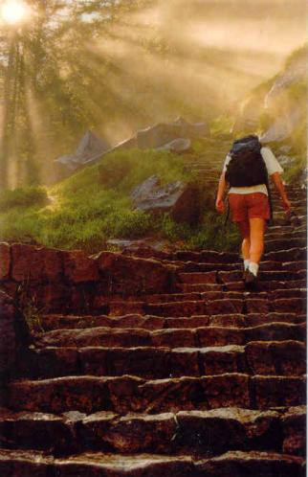
Seorang Murid… Menjalani Jalan
“Barangsiapa tidak memikul salibnya dan mengikut Aku, ia tidak dapat menjadi murid-Ku.” (Lukas 14:27)

Slide 67

Seorang Murid… Menunjukkan Jalan
“Karena itu pergilah, jadikanlah semua bangsa murid-Ku dan baptislah mereka dalam nama Bapa dan Anak dan Roh Kudus, dan ajarlah mereka melakukan segala sesuatu yang telah Kuperintahkan kepadamu. ” (Matius 28:19-20a)

Slide 68


Slide 69
3 Dimensi Pengajaran
Siapa
Bagaimana
Apa
Notes:
69
The Truth must permeate every part of the education process.
If the teacher is not transformed by Truth – the living Word of God, the Bible, and the Word, Jesus Christ Himself – he will tend to push people away from Christ rather than draw them toward Him. Nothing else works if this is missing. The truth must be integrated into the life of the teacher, transforming his or her thinking, feeling and behaving, before he or she can be used to transform the lives of students – parable of the sawdust and the plank (Matt 7:3-5, Luke 6:41-42).
I’m not going to address this part because it is addressed in every message, every Sunday School class, every tape, and every book and is relevant for every Christian whether they are a teacher or not. It is not that we have put everything into practise, but I want to focus on things are more exclusively related to education.
Because there is often great concern about what can or cannot be said in a public school – and public schools are where most of us have been trained and gotten our experience – many Christians focus on how to be a Christian in the classroom by considering their approach or methodology. Sometimes it doesn’t get much beyond being nice and being moral, but it is a start at considering what it means to having education which is Christian by nature and not just by name.
There is an interesting article by Donald Oppewal, Biblical Knowing and Teaching, a Calvin College Monograph, 1985 which addresses more of this question that I’d recommend for your reading enjoyment. I’d summarize the focus of this aspect of Christian education as being on relationships: teacher-student, student-teacher, student-student, teacher-teacher, teacher-administration, administration-teacher, teacher-parent, parent-teacher, parent-student, student-parent.
This is also critically important. There is a sense in which a teacher’s relationship to God and His Word will naturally transform their relationships with everyone else, but unless teachers consciously consider this aspect of Christian education it is likely they will be “like their teachers” (Luke 6:40) and operate in god-less or un-godly ways. After all, Rom. 12:2 says we are “transformed by the renewing of our mind” so if we don’t engage our minds, it is unlikely much transformation will take place.
It is the third aspect of Christian education that I believe from my own experience, is the least transformed. There are many reasons:
Most Christians have been trained by non-Christians
Most Christians have taught in situations where introducing Christ in the classroom was highly restricted
Most Christians operate as functional dualists with God and His Word only being relevant to “spiritual” things and not physical things.

Slide 70
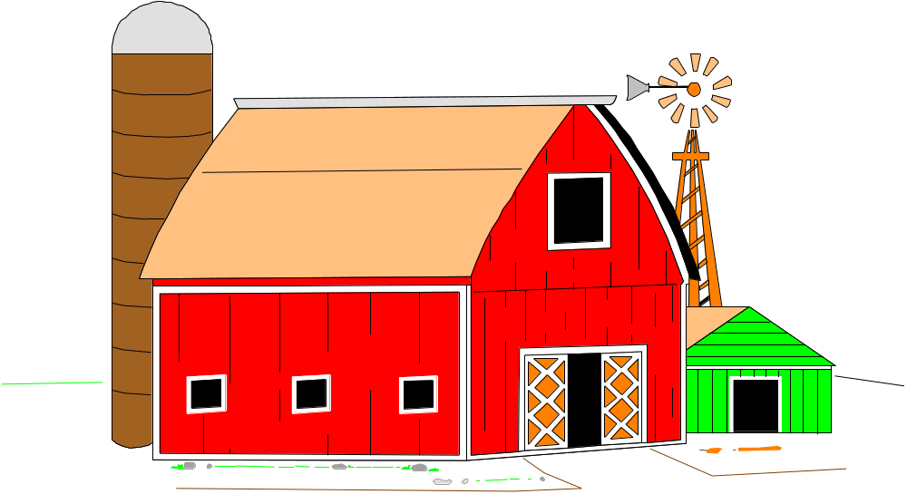
Membangun sebuah sistem pendidikan
Notes:
You start by trying to find out what the dimensions were supposed to be, what kind of footings were to be prepared (the ground is soft — excellent for agriculture), but work proceeds very slowly because everyone argues about how the various pieces should be assembled. What are the dimensions? How high should the structure be?

Slide 71

Constructing an educational system
Notes:
And then, in the midst of all the confusion, someone finds a bundle of gold and silver sheets wrapped in plastic in the midst of the pile. Things get really excited. Obviously someone really thought cows and horses were important for they wanted to decorate the barn in a spectacular way. Others argue that the gold and silver are there to pay for more materials to make the barn bigger. Some think that the noble metals are to be used in the feed troughs to prevent contamination of the food supply. And so the discovery of the gold and silver causes more conflict rather than solving anything.

Slide 72
Membangun sebuah sistem pendidikan
Notes:
And then, in the midst of all the confusion, someone finds a bundle of gold and silver sheets wrapped in plastic in the midst of the pile. Things get really excited. Obviously someone really thought cows and horses were important for they wanted to decorate the barn in a spectacular way. Others argue that the gold and silver are there to pay for more materials to make the barn bigger. Some think that the noble metals are to be used in the feed troughs to prevent contamination of the food supply. And so the discovery of the gold and silver causes more conflict rather than solving anything.

Slide 73
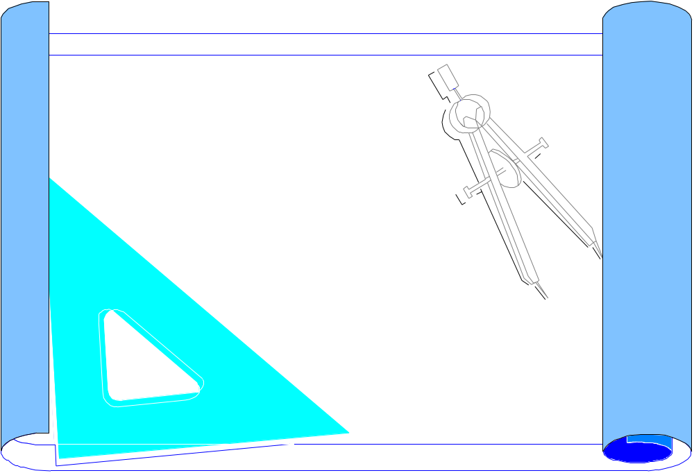
Constructing an educational system
Notes:
However, one of the workers gets curious about the bundle and begins looking closely at the sheets and discovers that they have all sorts of writing on them. In fact, they are the plans for the building.

Slide 74
Membangun sebuah sistem pendidikan
Notes:
However, one of the workers gets curious about the bundle and begins looking closely at the sheets and discovers that they have all sorts of writing on them. In fact, they are the plans for the building.

Slide 75
Notes:
Temple of Heaven, Beijing, China
When they are read carefully, it is obvious that they are not the plans for a barn, but for a cathedral. Some argue that seeing so much work has been done on the barn you might as well continue, others don’t want to disappoint the cows, but a few want to tear down the work that has been done and start over to make the building that was intended. The old has to be removed because the plans reveal that the solid rock bluff in the corner of the field that was useless for a barn, is supposed to be the foundation of the cathedral. The gold and silver aren’t to make a beautiful barn or even to make rust-proof troughs, but to glorify the God of all the earth.
We must be sure that when we start considering the matter of Biblical integration that we don’t allow the world’s philosophy or even our natural tendencies to guide the process. We must instead build on the foundation that has already been laid — Jesus Christ — and allow the Scriptures, the living Word of Almighty God, to direct everything that we build on that foundation. Only in this way will we produce anything of lasting, eternal value in our personal lives, in our families, in our churches and in our schools.
We must, therefore, begin by studying the Biblical framework of reality. We need to know the broad outlines of the plan that God has revealed to us so that as we fit together the pieces for which we are responsible we can do so with confidence and great joy. Jesus, the master Architect, is building His church and even though we may never have the opportunity to see more than a small corner of it, we can be sure that all that we do is integrated into His plan and He has promised to reward every faithful servant that build for His glory.
Hebrews 11:6
And without faith it is impossible to please God, because anyone who comes to him must believe that he exists and that he rewards those who earnestly seek him.
“In order for this kind of integration to take place, both students and teachers must be engaged in solid Bible study which makes them increasingly familiar with what the Bible says. In addition, every teacher must make a serious effort to learn what is taught in the Scriptures that relates to topics in his own curriculum.” (Haycock, 1981, x).

Slide 76
Perumpamaan Super
Alkitab bagaikan cetak biru
Alkitab bagaikan oksigen
Alkitab bagaikan drama yang belum selesai

Slide 77

Prioritas Alkitab
Apa yang Alkitab katakan selalu menjadi apa yang kita pikir kita temukan dalam dunia kita, dalam diri kita atau dalam hubungan dengan sesama kita
Apa yang Alkitab katakan selalu menjadi apa yang kita pikir “Allah beritahukan pada saya”

Slide 78
Alkitab, mengajar, dan Anda
Perikop Alkitab mana yang memberi pengaruh paling besar pada pemikiran dan karya Anda sebagai seorang guru?
  Jelaskan bagaimana perikop pilihan tersebut mempengaruhi pemikiran Anda.
  Ilustrasikan bagaimana perikop pilihan tersebut mengubah apa yang Anda lakukan sebagai guru.
Notes:
What passages of Scripture have had the greatest impact on your thinking and practise as a teacher?
Explain how the selected verses have affected your thinking.
Illustrate how they have changed your practise.
How does Christ fit in education? What is the role of the Bible in the classroom?
Does the kind of school in which you teach make a difference in your answers?
What are the greatest hindrances to Christ and the Bible having their proper place in your classroom?
Do your students understand what Christ-in education should be?
Can they tell others what they know?
Are they committed to giving Christ and the Bible their proper place?
How does God the Father and the Holy Spirit fit into education?
How does their role differ from that of Christ?
What does Christ bring to education that was not present in the Old Testament?
Why are you interested in teaching abroad?
What do you feel are the greatest needs in missions?
How do teachers fit in missions?
What experience and skills do you have that you can share with other teachers?
What do you expect will be the most difficult adjustment for you in teaching overseas?
What does the expression "missional Christian education" mean to you?
What are the most influential books/articles that you have read regarding Christian education?
What have you read in the past year on this topic?
What have you heard in the past year on this topic?

Slide 79
Ayat-ayat untuk Meditasi
Apa yang Anda pikirkan jika Anda mendengar ayat-ayat ini?
Lukas 6:40, Matius 28:18-20,
Roma 1:18-21, Roma 11:36-12:2,
1 Korintus 2:14, Kolose 1:16-17,
1 Petrus 3:15
Apa yang dikatakan ayat-ayat tersebut?
Apa maksud ayat-ayat tersebut?

Slide 80
Kebenaran yang Mengubahkan
Matius 28:18-20
Yesus mendekati mereka dan berkata: "Kepada-Ku telah diberikan segala kuasa di sorga dan di bumi. Karena itu pergilah, jadikanlah semua bangsa murid-Ku dan baptislah mereka dalam nama Bapa dan Anak dan Roh Kudus, dan ajarlah mereka melakukan segala sesuatu yang telah Kuperintahkan kepadamu. Dan ketahuilah, Aku menyertai kamu senantiasa sampai kepada akhir zaman."
Notes:
It takes one to make one – disciples that is.
The goal is to make disciples of all nations—not converts. The goal isn’t even to witness to everyone in all the world. The goal is to make disciples—people who are actively following Christ, imitating Him.
The foundation for everything we do is Christ’s authority which is not just a “pie-in-the-sky-by-and–by” kind of authority, but very definitely applies on earth as well as heaven. This isn’t something detached from us either for He is always with us.
The method:
1. Go – the disciples don’t come to us, we have to go to them
2. Baptizing – physical act is vital, but so is the spiritual truth of identification with the death and resurrection of Christ, obedience to God the Father, dependency on the power of the Holy Spirit, unity with the body of Christ
3. Teaching – obedience to everything Christ has commanded
If you’re not teaching, you’re not fulfilling the Great Commission of Jesus, because that’s how disciples are made.

Slide 81
Kata-kata yang Hilang
Pertobatan
Penginjilan
Gereja
Penyembahan
Kata-kata yang Mengejutkan
Pemuridan
Mengajar
Notes:
Where in these verses does it mention evangelism and church-planting?
Evangelism is pre-education; it is implied but not specifically stated.

Slide 82
Injil = Kabar Baik
Allah peduli
Allah hadir
Allah tidak diam
Allah maha kuasa
Notes:
Luke 4:18-21
"The Spirit of the Lord is on me,
because he has anointed me
to preach good news to the poor.
He has sent me to proclaim freedom for the prisoners
and recovery of sight for the blind,
to release the oppressed,
to proclaim the year of the Lord's favor."
Then he rolled up the scroll, gave it back to the attendant and sat down. The eyes of everyone in the synagogue were fastened on him, and he began by saying to them, "Today this scripture is fulfilled in your hearing."
Luke 7:22 And He answered and said to them, "Go and report to John what you have seen and heard: the blind receive sight, the lame walk, the lepers are cleansed, and the deaf hear, the dead are raised up, the poor have the GOSPEL PREACHED TO THEM.

Slide 83
Kebenaran yang Mengubahkan
Markus 12:30-31
Kasihilah Tuhan, Allahmu, dengan segenap hatimu dan dengan segenap jiwamu dan dengan segenap akal budimu dan dengan segenap kekuatanmu. Dan hukum yang kedua ialah: Kasihilah sesamamu manusia seperti dirimu sendiri. Tidak ada hukum lain yang lebih utama dari pada kedua hukum ini.

Slide 84
Kebenaran yang Mengubahkan
Lukas 6:40
Seorang murid tidak lebih dari pada gurunya, tetapi barangsiapa yang telah tamat pelajarannya akan sama dengan gurunya.

Slide 85
Kebenaran yang Mengubahkan
Roma 1:18-20
…Karena apa yang dapat mereka ketahui tentang Allah nyata bagi mereka, sebab Allah telah menyatakannya kepada mereka. Sebab apa yang tidak nampak dari pada-Nya, yaitu kekuatan-Nya yang kekal dan keilahian-Nya, dapat nampak kepada pikiran dari karya-Nya sejak dunia diciptakan, sehingga mereka tidak dapat berdalih.

Slide 86
Kebenaran yang Mengubahkan
Romans 11:36-12:2
Sebab segala sesuatu adalah dari Dia, dan oleh Dia, dan kepada Dia: Bagi Dialah kemuliaan sampai selama-lamanya! Karena itu, saudara-saudara, demi kemurahan Allah aku menasihatkan kamu, supaya kamu mempersembahkan tubuhmu sebagai persembahan yang hidup, yang kudus dan yang berkenan kepada Allah: itu adalah ibadahmu yang sejati. Janganlah kamu menjadi serupa dengan dunia ini, tetapi berubahlah oleh pembaharuan budimu, sehingga kamu dapat membedakan manakah kehendak Allah: apa yang baik, yang berkenan kepada Allah dan yang sempurna.

Slide 87
Kebenaran yang Mengubahkan
1 Korintus 2:14
Tetapi manusia duniawi tidak menerima apa yang berasal dari Roh Allah, karena hal itu baginya adalah suatu kebodohan; dan ia tidak dapat memahaminya, sebab hal itu hanya dapat dinilai secara rohani.

Slide 88
Kebenaran yang Mengubahkan
Kolose 1:16-17
karena di dalam Dialah telah diciptakan segala sesuatu, yang ada di sorga dan yang ada di bumi, yang kelihatan dan yang tidak kelihatan, baik singgasana, maupun kerajaan, baik pemerintah, maupun penguasa; segala sesuatu diciptakan oleh Dia dan untuk Dia. Ia ada terlebih dahulu dari segala sesuatu dan segala sesuatu ada di dalam Dia.

Slide 89
Kebenaran yang Mengubahkan
1 Petrus 3:15
Tetapi kuduskanlah Kristus di dalam hatimu sebagai Tuhan! Dan siap sedialah pada segala waktu untuk memberi pertanggungan jawab kepada tiap-tiap orang yang meminta pertanggungan jawab dari kamu tentang pengharapan yang ada padamu, tetapi haruslah dengan lemah lembut dan hormat.

Slide 90
Membuat perbedaan kekal
Guru yang diubahkan
Guru yang mengubahkan
Murid yang diubahkan
Murid yang mengubahkan
Dunia yang diubahkan

Slide 91
Guru-guru Amanat Agung
Diubahkan (Roma 12:2)
Mengubah
Pengubah

Slide 92
Mengubahkan
Memuridkan
Mengajarkan cara pandang dunia
Menghubungkan segala hal dengan Kristus dan Firman-Nya
Mengasihi murid-murid-Nya.

Slide 93
Diubahkan
Dipanggil untuk mengajar
Komit pada pemuridan
Kompeten dalam menghubungkan segenap hidup dan pembelajaran dengan Allah dan Firman-Nya

Slide 94
Sentralitas Firman
Alkitab
segala hal lain
Notes:
94

Slide 95
Dualisme dalam Praktek
Mereka mengajarkan segala sesuatu yang lain
Kita mengajarkan Alkitab
Notes:
95
Excellence
Ethics
Evangelism

Slide 96
Dualisme dalam Praktek
Yesus
tidak relevan
Yesus Juru Selamat
Tuhan?
Notes:
96

Slide 97
Dualisme dalam Praktek
E
Mereka mengajarkan segala sesuatu yang lain
Kita mengajar Alkitab
E
E
Notes:
97
Excellence
Ethics
Evangelism

Slide 98
Apa yang Utama?
ALLAH
MANUSIA
ALAM
Ilmu Alam
Ilmu Sosial
Filosofi & Agama
Notes:
There are three basic ways of looking at everything. The modern world put science and the natural sciences at the centre and made everything else peripheral although the social sciences fought to be recognized as “real” sciences that contributed important information about people the way the natural sciences did about the animate (all living creatures except people) and inanimate world (non-living, material universe).

Slide 99
Apa yang Utama?
ALLAH
ALAM
MANUSIA
Ilmu Sosial
Ilmu Alam
Filosofi & Agama
Notes:
The post-modern philosophy has been a strong reaction to the “man as biological machine” view that resulted from looking at everything with science in the center. Instead mankind is given the central role as meaning-maker. In both cases, however, God is considered as irrelevant if He happens to exist. At best He has personal private meaning, but should have no impact on the “real” world where science and man vie for the lead role.

Slide 100
Apa yang Utama?
ALAM
MANUSIA
ALLAH
Teologi, Etika
Ilmu Sosial
Ilmu Alam
Notes:
Some Christians have concluded that because God is central, everything else can be ignored, but this really reveals an inadequate understanding of God’s relationship to all that He has made. Although His relationship to man is of primary importance, this relationship has implications for man’s relationship to all the rest of God’s creation.

Slide 101

Arah Integrasi
Cara pandang alami, temporal + Allah
tidak berhasil
God
Notes:
We need to develop a godly worldview and then all the details of this natural world will fit.
Acts 17:24-28
"The God who made the world and everything in it is the Lord of heaven and earth and does not live in temples built by hands. [25] And he is not served by human hands, as if he needed anything, because he himself gives all men life and breath and everything else. [26] From one man he made every nation of men, that they should inhabit the whole earth; and he determined the times set for them and the exact places where they should live. [27] God did this so that men would seek him and perhaps reach out for him and find him, though he is not far from each one of us. [28] 'For in him we live and move and have our being.' As some of your own poets have said, 'We are his offspring.'
Plantinga, Alvin. Advice to Christian philosophers. 2000.10.03. http://www.leaderu.com/truth/1truth10.html
“We Christians are heavily influenced by the practice and procedures of our non-Christian peers. There are ways of proceeding, pervasive assumptions about the nature of the discipline, assumptions about how the discipline should be carried on and what a valuable or worthwhile contribution is like and so on; we imbibe these assumptions, if not with our mother’s milk, at any rate in learning to pursue our disciplines. We learn how to pursue our disciplines under the direction and influence of our peers.”
“In many cases these assumptions and presumptions do not easily mesh with a Christian or theistic way of looking at the world.”
“Christians must display autonomy and integrality.”
If contemporary pedagogy assumes that human nature is basically good than something other than contemporary pedagogy is called for; and the Christian community must develop it.
“The fundamental and often unexpressed presuppositions that govern and direct the discipline are not religiously neutral; they are often antithetic to a Christian perspective. It is up to Christians who practice the relevant discipline to develop the right Christian alternatives.”
More autonomy – more independence of the rest of the educational world
The Christian…has the perfect right to the point of view and pre-philosophical assumptions he brings to philosophic work; the fact that these are not widely shared outside the Christian or theistic community is interesting but fundamentally irrelevant.
More integrity – more wholeness or unity, being all of one piece
The Christian educator who looks exclusively to the educational world at large, who thinks of himself as belonging primarily to that world, runs a two-fold risk. He may neglect an essential part of his task as a Christian philosopher; and he may find himself adopting principles and procedures that don’t comport well with his beliefs as a Christian.
“We must not automatically assimilate what is current or fashionable or popular … for much of it comports ill with Christian ways of thinking.”
More Christian courage, boldness, strength, Christian self-confidence – trust in the the Lord and His Word
“Perhaps we could proceed without appealing to what we believe as theists; by why should we, if these beliefs are useful and explanatory? I could probably get home this even by hopping on one leg …. But why should I want to?”
“We who are Christians and propose to be teachers must not rest content with being teachers who happen, incidentally, to be Christians; we must strive to be Christian teachers. We must therefore pursue our projects with integrity, independence and Christian boldness.

Slide 102
Arah Integrasi
Allah + dunia alam
berhasil
God
Notes:
We need to develop a godly worldview and then all the details of this natural world will fit.
Acts 17:24-28
"The God who made the world and everything in it is the Lord of heaven and earth and does not live in temples built by hands. [25] And he is not served by human hands, as if he needed anything, because he himself gives all men life and breath and everything else. [26] From one man he made every nation of men, that they should inhabit the whole earth; and he determined the times set for them and the exact places where they should live. [27] God did this so that men would seek him and perhaps reach out for him and find him, though he is not far from each one of us. [28] 'For in him we live and move and have our being.' As some of your own poets have said, 'We are his offspring.'
Plantinga, Alvin. Advice to Christian philosophers. 2000.10.03. http://www.leaderu.com/truth/1truth10.html
“We Christians are heavily influenced by the practice and procedures of our non-Christian peers. There are ways of proceeding, pervasive assumptions about the nature of the discipline, assumptions about how the discipline should be carried on and what a valuable or worthwhile contribution is like and so on; we imbibe these assumptions, if not with our mother’s milk, at any rate in learning to pursue our disciplines. We learn how to pursue our disciplines under the direction and influence of our peers.”
“In many cases these assumptions and presumptions do not easily mesh with a Christian or theistic way of looking at the world.”
“Christians must display autonomy and integrality.”
If contemporary pedagogy assumes that human nature is basically good than something other than contemporary pedagogy is called for; and the Christian community must develop it.
“The fundamental and often unexpressed presuppositions that govern and direct the discipline are not religiously neutral; they are often antithetic to a Christian perspective. It is up to Christians who practice the relevant discipline to develop the right Christian alternatives.”
More autonomy – more independence of the rest of the educational world
The Christian…has the perfect right to the point of view and pre-philosophical assumptions he brings to philosophic work; the fact that these are not widely shared outside the Christian or theistic community is interesting but fundamentally irrelevant.
More integrity – more wholeness or unity, being all of one piece
The Christian educator who looks exclusively to the educational world at large, who thinks of himself as belonging primarily to that world, runs a two-fold risk. He may neglect an essential part of his task as a Christian philosopher; and he may find himself adopting principles and procedures that don’t comport well with his beliefs as a Christian.
“We must not automatically assimilate what is current or fashionable or popular … for much of it comports ill with Christian ways of thinking.”
More Christian courage, boldness, strength, Christian self-confidence – trust in the the Lord and His Word
“Perhaps we could proceed without appealing to what we believe as theists; by why should we, if these beliefs are useful and explanatory? I could probably get home this even by hopping on one leg …. But why should I want to?”
“We who are Christians and propose to be teachers must not rest content with being teachers who happen, incidentally, to be Christians; we must strive to be Christian teachers. We must therefore pursue our projects with integrity, independence and Christian boldness.

Slide 103
Valet Visual
© Harold Klassen 2003
© Harold Klassen 2003
Notes:
103

Slide 104

Kerangka Kerja Kristen
Penciptaan
Pemenuhan
Penebusan
Kejatuhan
© Harold Klassen 2003
Notes:
104

Slide 105

Kerangka Kerja Kristen
Penciptaan
Kejatuhan
Penebusan
© Harold Klassen 2003

Slide 106
Tujuan Kekal Allah
Anak-anak Allah
Tubuh Kristus
Bait Roh Kudus
Notes:
106

Slide 107
Membangun kerangka kerja
Realita
  Pencipta
  Ciptaan
    Benda (tidak bergerak)
    Ciptaan (bergerak)
    Manusia (Sesama)
    Diri Sendiri
    Makhluk spiritual

Slide 108
Membangun kerangka kerja
Relasi
  Allah <-> ciptaan (vertical)
  Ciptaan <-> ciptaan (horizontal)
Konsekuensi
  Bagaimana kejatuhan mempengaruhi __________?
  Bagaimana penebusan Kristus mempengaruhi __________?

Slide 109
SUCI
Hal-hal yang spiritual, kekal, dan tidak berubah, berada di alam atas Allah di surga
SEKULER
Hal-hal yang fisik, terbatas, dan berubah, berada di alam bawah manusiadi bumi
© Christian Overman, Assumptions that affect our lives, 1996, p. 181
Notes:
One of the major problems I had was a severe case of dualism. I was used to thinking like the Greeks that you could divide up everything you knew into two categories, the sacred and the secular. In the sacred category were all the really important things like God, God’s will, devotions, witnessing, prayer, worship and church. Everything else fitted into the secular category. I’d learned that it was less important because when we came to church we were told to put everything from the week out of our mind so we could worship. I’d always had Christian teachers for the “sacred” things, but the secular things were obviously OK to be taught by non-Christians like my peers, school, employer, media, Internet, etc.
The “Jesus is Saviour” vs. “Jesus is Lord” controversy was alive in my youth group with many of my peers struggling to see why we needed to have Jesus as Lord, worrying about the secular things, if we had Him as Saviour, taking care of the sacred things. After all, what did God really have to do with my family, work, leisure, entertainment, travel, food, clothes, transportation, chemistry, physics, mathematics, literature, astronomy, ecology, or schools?

Slide 110
Ger
Sek
Se
Rum
Mu
Dra
Olah
Bis
Hu
Bur
Agrik
Se
Kedok
Meng
eja
olah
ni
ah
sik
ma
raga
nis
kum
uh
ultur
ks
teran
ajar
Dalam konflik dengan desain Allah
(“jahat”)
Sesuai dengan desain Allah
(“baik”)
© Christian Overman, Assumptions that affect our lives, 1996, p. 181
Notes:
My problem is that I had never been taught that God had something to say about everything—or at least I had completely missed the point of the teaching. I was in the middle of a struggle between doing everything my way or God’s way. It wasn’t a question of which things were “God things” and which things were not, but whether each thing was being done God’s way or not.

Slide 111
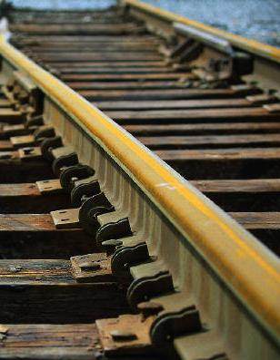
Pemikiran
Dua Jalur
Jalur Sains
Umum
Natural
Nalar
Jalur Agama
Pribadi
Supra-
natural
Iman

Slide 112

Panduan Integrasi Alkitabiah
Refleksi
Aplikasi
Pewahyuan
Distorsi
© Harold Klassen 2003
Notes:
112

Slide 113
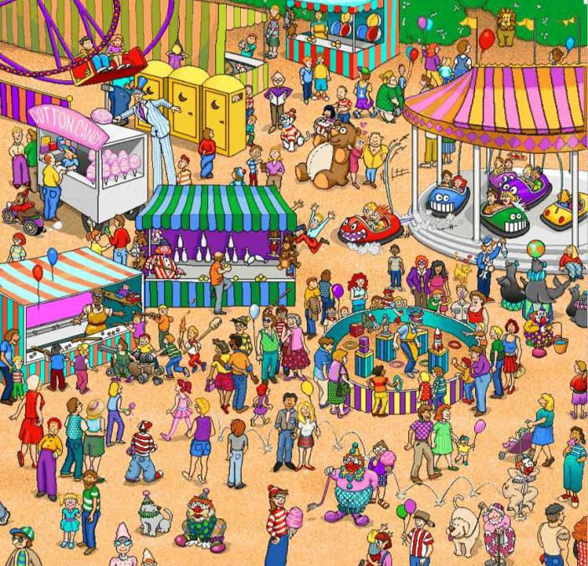

Di Mana Waldo?

Slide 114


Slide 115
Allah
Malaikat
Spiritual
Iblis
Ciptaan
Man
Transportasi
Teknologi
Bangunan
Musik
Physical
Jasa Makanan
Seni
Sejarah
Sains
Bahasa

Slide 116
2 + 2 = 4
Mengapa benar?
  Penciptaan?
  Penemuan?
  Pencarian?
  Pewahyuan?

Slide 117
Pewahyuan
Fondasi Cara Pandang Kristen

Slide 118
Pewahyuan pada saat Penciptaan
Penting
Agung
Konsisten
Harmonis
Fokus pada Pencipta
Notes:
Revelation – implies a showing or exposure of something hidden or unknown
→ Creator
God didn’t have to reveal Himself to us. He chose to. We have no record of Jesus interacting with animals even though He made them and they are marvelous demonstrations of His creativity and they reveal all kinds of glimpses of His character. In fact the Bible talks a lot about what we can learn from various animals. However, He didn’t reveal Himself to animals; instead He used animals to reveal Himself to us.

Slide 119
Pewahyuan pada saat Penciptaan
Fokus pada Pencipta
Supranatural
Khusus
Spiritual
Terbatas
Penting
Sempurna
Natural
Umum
Material
Terbatas
Tidak cukup
Baik

Slide 120
Pewahyuan pada saat Penciptaan
Karya Allah
  Kebenaran diaplikasikan
Berjalan bersama Allah
  Kebenaran dalam relasi
Firman Allah
  Kebenaran diberitakan
Alam semesta
  Tidak bergerak
  Bergerak
Manusia
  Gambar & rupa Allah
  Berelasi
Individual
  Hidup dalam Allah
  Taat pada Allah

Slide 121
Pewahyuan setelah Kejatuhan
Fokus pada Pencipta
Fokus pada Ciptaan
Supranatural
Khusus
Spiritual
Terbatas
Penting
Sempurna
Natural
Umum
Material
Terbatas
Tidak cukup
Berdosa
Notes:
Sinful
Distorted
Dying
Deceitful
Desperately wicked
General revelation is a distorted picture of the Creator because of sin.
Dying – 2nd law of thermodynamics describes the degenerative nature of all physical process left to themselves; people all die, all animal life dies, the entire universe is degenerating towards a common temperature at which nothing will happen as all the hot things cool and the cold things warm
Deceitful – human relationships of all kind have been poisoned by the deceitfulness of our hearts (Jeremiah 17:9 The heart is deceitful above all things, and desperately wicked: who can know it?). We’re unable to tell the truth to others or ourselves. The family resemblance shows (John 8:44 You belong to your father, the devil, and you want to carry out your father's desire. He was a murderer from the beginning, not holding to the truth, for there is no truth in him. When he lies, he speaks his native language, for he is a liar and the father of lies.)
Desperately wicked – beyond cure, incurable, desperately sick, perverse, exceedingly corrupt. We talk about “sick” jokes, but we’re all sick. Part of our deceitfulness is to try to hide our problem, but 1 John 1:8-10 says “If we claim to be without sin, we deceive ourselves and the truth is not in us. [9] If we confess our sins, he is faithful and just and will forgive us our sins and purify us from all unrighteousness. [10] If we claim we have not sinned, we make him out to be a liar and his word has no place in our lives.”
Use the aluminum foil and mirror illustration to show distortion and how the same reflector that reflects God when He is with me, reflects me when God isn’t with me, when something comes between us.

Slide 122
Pewahyuan setelah Kejatuhan
Karya Allah
  Kebenaran diaplikasikan
Berjalan bersama Allah
  Kebenaran dalam relasi
Firman Allah
  Kebenaran diberitakan
Alam semesta
  Kematian
Manusia
  Konflik & pengkhianatan
Individu
  Berdosa – Egois & sombong
Notes:
General revelation was always inadequate, but after the fall it was even more inadequate because now both the sources of revelation and the responder to revelation have been devastated by sin.

Slide 123
Asal Kesalahan
Kebenaran Allah
“Sekeping Kebenaran”
Mark Eckel

Slide 124
Asal Kesalahan
Kebenaran Allah
Mark Eckel

Slide 125
Asal Kesalahan
Kebenaran Allah ditolak & dilupakan
ISM
- “Kepingan menjadi keseluruhan”
Mark Eckel
Notes:
Humanism – man is everything
Pantheism – everything is God
Materialism – matter is everything
Hedonism – pleasure is everything
Pragmatism – results are everything

Slide 126
Panduan Pertanyaan Besar
Apa yang baik, indah, benar, berharga?
Apa tujuannya?
Bagaimana kita tahu? Bagaimana kita memilih? Apa konsekuensinya?
Apa yang buruk, jelek, salah, tidak berharga?
© Harold Klassen 2003
Notes:
126

Slide 127
Membuat kurikulum sekolah negeri cocok bagi sekolah Kristen
Wolfgang Reuter
Georg-Müller-Schule, Detmolder Straße 284, 33605 Bielefeld, Germany
w.reuter@gms-net.de
Notes:
127
Title
“Vom öffentlichen zum christlichen Lehrplan” (Making the state school curriculum fit for Christian schools).
Type of Material
Essay on Curriculum Development.
Target group
Teachers at Christian Schools.
Author and country of origin / contact
Wolfgang Reuter, Germany.
Georg-Müller-Schule, Detmolder Straße 284, 33605 Bielefeld, Germany
w.reuter@gms-net.de.
Original language
German.
Summary
“Vom öffentlichen zum christlichen Lehrplan”
Christian schools in Germany are expected to use the state school curriculum, which, however can be modified and adapted to the specific needs of these schools. The author discusses the suitability of the state school curriculum and presents twelve steps that help modify the official curriculum and establish a specific curriculum for Christian schools.
These operations apply to topics, texts or assignments. They include: (1) adding, (2) omitting, (3) exchanging, (4) rearranging, (5) focussing, (6) ignoring, (7) modifying, (8) correcting, (9) assessing, (10) comparing, (11) linking and (12) putting into practice. For each of these steps one or more examples are given and objectives pointed out.
Reference to reality tests
The essay reflects the work done by some of the departments of Georg Müller Christian School, Bielefeld (Germany).

Slide 128
12 Langkah
Menambahkan
Menghilangkan
Menukar
Mengatur ulang
Fokus
Mengabaikan
Notes:
128
Wolfgang Reuter
Vom öffentlichen zum christlichen Lehrplan
Wir gehen in unseren freien christlichen Bekenntnisschulen in Deutschland in aller Regel vom öffentlichen Lehrplan aus. Deshalb sind unsere Schulen Ersatzschulen. Trotz verschiedener Vorbehalte erkennen wir an, dass der staatliche Lehrplan viele nützliche Elemente enthält in Bezug auf Wissen, Fertigkeiten und Methoden. Darum haben wir beispielsweise bestimmte vom Schulministerium für öffentliche Schulen zugelassene Lehrwerke für unseren Unterricht ausgewählt, von denen wir eine Grundlage für guten Unterricht erwarten und mit denen wir in der Regel positive Erfahrungen machen oder gemacht haben.
Viele ganz „normale“, d.h. säkulare Themen, Methoden und Lernziele fördern durchaus Aspekte des christlichen Lebens. Wer zum Beispiel eine ganz normale Lesekompetenz erwirbt, hat leichteren Zugang zu biblischen Texten und zu Auslegungen; er versteht sowohl die mitgeteilten Fakten als auch zugrunde liegende Haltungen und Aussageabsichten besser. – Wer eine ganz normale Sprechkompetenz erworben hat, wer Präsentationstechniken beherrscht, kann auch in der Gemeinde vermitteln, leiten, kommunizieren usw. – Wer Grundlagen geschichtlichen Denkens erworben hat, dem erschließt sich auch die historische Dimension biblischer Berichte eher. – Wer biologische Zusammenhänge versteht, z.B. die Funktion des menschlichen Auges, lernt, die Größe des Schöpfers zu bestaunen, selbst wenn das im Unterricht überhaupt nicht ausdrücklich erwähnt wird.
Doch das genügt uns nicht. Unsere Verantwortung vor Gott führt uns zu speziellen, an der Bibel orientierten Zielsetzungen, die unseren Lehrplan im Vergleich zum staatlichen Curriculum verändern und die letztlich auch zu einer Unterschiedlichkeit des Lebens und – wenn es gelingt – des pädagogischen Klimas an unseren Schulen führen.
Folgende Bedingungen und Voraussetzungen bestimmen unser Tun an christlichen Schulen:
1 Wir wollen fachlich und didaktisch qualifizierten Unterricht machen, der den Schülern ein umfassendes, geordnetes und verwendbares Wissen vermittelt und sie zu selbständigem Planen, Beurteilen und Handeln anregt.
Siehe dazu nahezu alle christlichen Schulkonzepte, z.B. das Konzept der August-Hermann-Francke Schule in Gießen, S. 5 (Gymnasium) und S. 8 (oben).
2 Gott hat etwas mit diesem Unterricht zu tun, weil Gott eine Sicht für menschliches Planen, Beurteilen und Handeln hat.
Siehe verschiedene Ausarbeitungen von Berthold Meier, Geschäftsführer der Arbeitsgemeinschaft evangelischer Bekenntnisschulen (AEBS).
3 Weil wir uns der Notwendigkeit und der Möglichkeiten biblischer Integration in unseren Fächern bewusst sind, reflektieren wir unsere Fächer und Fachbereiche unter diesem Aspekt („Sachanalyse“) – zunächst einmal unabhängig davon, ob ein spezielles „integrierendes“ Curriculum existiert. Das bedeutet noch nicht, dass wir jede Anknüpfungsmöglichkeit auch nutzen.
Biblische Integration ist oft nicht in Bezug auf einzelne Unterrichtsinhalte sinnvoll – sie wäre dann willkürlich punktuell –, sondern ist über die Vermittlung eines allgemeinen Grundverständnisses zu erzielen. Beispiele:
Geschichte: „Gott greift in die Geschichte ein.“ / „Gott macht Geschichte.“ (Amos 3, 6)
Biologie: „Die Schöpfung ist ein Kunstwerk des Schöpfers.“ / „Sie spiegelt seine Kreativität wider.“
Sprache: „Gelungene Kommunikation ist eine unabdingbare Voraussetzung für gelungene Beziehungen / für ein funktionierendes Gemeindeleben.“
4 Wir halten uns grundsätzlich bereit, den Bezug zu Gott, Glauben und Bibel ausdrücklich herzustellen. Wir nutzen auch spontan unerwartete Anlässe im Unterricht.
Beispiel: Behandlung von Gospels und Spirituals im Englischunterricht, Schüleraussage: „Das können keine Christen sein – die schreien ja so!“ Unterrichtsthema daraufhin: Was ist ein Christ?
5 Aber wir gehen behutsam mit diesem Gut um. Wir behalten die Voraussetzungen und Befindlichkeiten unserer Schüler im Blick. Wir entwerten Gottes Perspektive nicht durch zu große Breite, durch Banalitäten oder Polemik.
Die folgenden Operationen bestimmen unseren Weg vom öffentlichen zum christlichen Lehrplan. Nicht alle dieser Operationen sind gleich häufig oder gleich umfassend. Einige stellen auch Sonderfälle anderer dar (z.B. der Vergleich als Sonderfall der Beurteilung).
1. Hinzufügen
Ein Thema, ein Text oder eine Aufgabe wird hinzugefügt. Das vorgegebene Pensum wird um diesen Aspekt ergänzt.
Beispiele: Behandlung der Frage mit do (Englisch): Lied „How did Moses cross the Red Sea“; Buchlektüre „The Twelfth Day of July”: Handouts zur Geschichte des Konflikts in Irland und zu Positionen der katholischen Kirche; Mathematik: Rechenaufgaben zur Bibel; Erdkunde: Mission in einem Land; Biologie: Staunen über die Schönheit der Schöpfung, z.B. bei Schmetterlingen.
Gründe: Ein wichtiges Thema um christliche Aspekte ergänzen, z.B. um notwendige Informationen; oder einfach die Chance nutzen, um biblische Inhalte präsenter werden zu lassen.
2. Weglassen
Ein Thema / Text / Aufgabe des Lehrplans / Lehrwerks wird aus biblisch orientierten Gründen weggelassen und nicht durch ein anderes ersetzt.
Beispiele: Ein Lehrbuchtext über Halloween, ein Horoskop, Der Zauberlehrling, bestimmte Geschichten von Michael Ende
Gründe: Textaussage oder Details widersprechen der Bibel, sind z.B. blasphemisch, okkult, obszön; würden verwirren / auf Unverständnis stoßen; widersprechen Erwartungen von Gruppen an der Schule.
3. Austauschen
Ein Text, der der Bibelorientierung des Unterrichts mehr entspricht, tritt an die Stelle eines anderen, der nicht gewünscht wird.
Beispiele: Behandlung der Amish als Minderheit in den USA statt der Native Americans; Biographie eines Christen statt Biographie eines weltlichen Stars.
Gründe: wie bei Hinzufügen und Weglassen
4. Zuordnen
Einem (verbindlichen) Thema, dessen Ausgestaltung der Lehrplan relativ offen lässt, werden Unterthemen / Texte zugeordnet, die aufgrund ihres Bezugs zur Bibel ausgewählt werden.
Beispiele: Die verbindliche Unterrichtsreihe zu Minoritäten wird durch das Thema „The Amish“ – eine christlich motivierte Gruppe – gefüllt. Das Thema „Liebe“ wird mit Hilfe verschiedener biblischer Texte und christlicher Lieder ausgestaltet.
Gründe: Freiheiten / Leerstellen im Lehrplan nutzen; fachliche Lernziele lassen sich uneingeschränkt erreichen.
5. Fokussieren
Diejenigen Aspekte eines Themas / eines Textes werden besonders bearbeitet, die biblische Bezüge aufweisen.
Beispiele: Brave New World – Schwerpunkt auf der Auseinandersetzung von Mustapha Mond über die Notwendigkeit Gottes; China / Menschenrechte: Schwerpunkt auf der Situation der Christen
Grund: offensichtlich.
Hinweis: Die Schwerpunktsetzung muss „fair“ sein, darf das Thema / den Text nicht verzerren und die Schüler nicht manipulieren.
6. Ignorieren
Dies ist eine auf den ersten Blick überraschende „Operation“: Trotz möglicher Bezüge werden diese nicht ausgeführt. Der Grund kann darin liegen, dass der Lehrer das Problem einmal vorab geklärt hat.
Beispiele: Tabelle über die Urgeschichte, Text zur Empfängnisverhütung
Gründe: Schüler nicht überfordern / überfüttern; Rücksicht auf nichtchristliche Schüler / auf den Entwicklungsstand der Schüler; Förderung der Selbständigkeit
7. Modifizieren
Ein vorgegebener Text wird im wesentlichen beibehalten, aber Daten oder einzelne Aussagen werden verändert, evtl. werden einzelne Passagen gekürzt oder Anmerkungen angefügt.
8. Korrigieren
Sonderfall der Modifikation: Falsche Angaben werden korrigiert.
Beispiele: Tabelle zur Frühgeschichte, Behauptungen über Kreationisten
Grund / Ziel: Vermittlung korrekter Daten
9. Beurteilen
Ein unveränderter Text wird im Unterricht beurteilt; das geschieht nicht ex cathedra vom Lehrer, sondern mit den Schülern. Beurteilt werden können angebliche Fakten, Verhalten, Schwerpunktsetzungen, sprachliche Manipulationen usw.
Beispiele: Geschichtliche Quellen, literarische Texte, naturwissenschaftliche Behauptungen.
Ziele: Erziehung der Schüler zur Selbständigkeit, Training, Hinterfragen
10. Vergleichen
Sonderfall der Beurteilung: Um die Beurteilung oder eine Zuordnung zu ermöglichen, wird ein ähnlich gelagerter Fall (Text) herangezogen.
Beispiele: Liebesgedicht von Goethe / Auszug aus dem Hohenlied, Beschreibung gesellschaftlicher Zustände / biblischer Bericht aus Israel, utopische Entwürfe / Ideal des Gemeindelebens oder Ausblick auf die Zukunft im Neuen Testament.
Ziele: wie bei Beurteilen, plus: Schwerpunkt auf biblische Grundlage legen.
11. Finden
Biblische oder kirchengeschichtliche oder theologische Hintergründe und Grundlagen werden entdeckt.
Beispiele: Alttestamentliche Bezüge in Martin Luther Kings Reden; Vorstellungen des American Dream
Ziele: offensichtlich
12. Handeln
Ein christlicher Impuls aus dem Unterricht wird umgesetzt.
Beispiele: Gebetsrunde für Christen in … / für die politische Situation in …; Dank an Gott für die Schöpfung; Sammeln für …; Kontakte knüpfen mit Missionaren / Schülern in …; Einsatz in der Öffentlichkeit gegen konkretes Unrecht oder für ein als gut erkanntes Anliegen
Ziele: Von der Theorie zur Praxis; konsequent leben.
Die Überlegungen der vorherigen Seiten werden relativiert durch die Erfahrung und die Überzeugung, dass, wenn es darum geht, in der Schule Menschen für Jesus zu gewinnen oder Christen im Glauben zu begleiten und weiterzuführen, das Wesentliche, das wir tun können, durch wertschätzenden Umgang miteinander geschieht, wahrscheinlich sogar überwiegend außerhalb des Fachunterrichts.
Zum Schluss dürfen wir uns über eine Entlastung freuen: Das Wesentliche überhaupt bewirkt Gott selbst. Er ist es, der unsere Schüler anspricht und ihre Herzen berührt, und er ist es, der uns selbst sensibel macht und mit der Liebe ausfüllt, die nicht nur unsere Schüler und Kollegen so sehr brauchen.
(Dieser Artikel basiert auf einem Vortrag, den ich im Oktober 2004 im Rahmen einer Lehrerfortbildung zum Thema „Biblische Integration“ in Berlin gehalten habe. Diese Überarbeitung: 21. April 2006)

Slide 129
12 Langkah
Memodifikasi
Membetulkan
Menilai
Membandingkan
Menghubungkan
Menjalankan
Notes:
129
Wolfgang Reuter
Vom öffentlichen zum christlichen Lehrplan
Wir gehen in unseren freien christlichen Bekenntnisschulen in Deutschland in aller Regel vom öffentlichen Lehrplan aus. Deshalb sind unsere Schulen Ersatzschulen. Trotz verschiedener Vorbehalte erkennen wir an, dass der staatliche Lehrplan viele nützliche Elemente enthält in Bezug auf Wissen, Fertigkeiten und Methoden. Darum haben wir beispielsweise bestimmte vom Schulministerium für öffentliche Schulen zugelassene Lehrwerke für unseren Unterricht ausgewählt, von denen wir eine Grundlage für guten Unterricht erwarten und mit denen wir in der Regel positive Erfahrungen machen oder gemacht haben.
Viele ganz „normale“, d.h. säkulare Themen, Methoden und Lernziele fördern durchaus Aspekte des christlichen Lebens. Wer zum Beispiel eine ganz normale Lesekompetenz erwirbt, hat leichteren Zugang zu biblischen Texten und zu Auslegungen; er versteht sowohl die mitgeteilten Fakten als auch zugrunde liegende Haltungen und Aussageabsichten besser. – Wer eine ganz normale Sprechkompetenz erworben hat, wer Präsentationstechniken beherrscht, kann auch in der Gemeinde vermitteln, leiten, kommunizieren usw. – Wer Grundlagen geschichtlichen Denkens erworben hat, dem erschließt sich auch die historische Dimension biblischer Berichte eher. – Wer biologische Zusammenhänge versteht, z.B. die Funktion des menschlichen Auges, lernt, die Größe des Schöpfers zu bestaunen, selbst wenn das im Unterricht überhaupt nicht ausdrücklich erwähnt wird.
Doch das genügt uns nicht. Unsere Verantwortung vor Gott führt uns zu speziellen, an der Bibel orientierten Zielsetzungen, die unseren Lehrplan im Vergleich zum staatlichen Curriculum verändern und die letztlich auch zu einer Unterschiedlichkeit des Lebens und – wenn es gelingt – des pädagogischen Klimas an unseren Schulen führen.
Folgende Bedingungen und Voraussetzungen bestimmen unser Tun an christlichen Schulen:
1 Wir wollen fachlich und didaktisch qualifizierten Unterricht machen, der den Schülern ein umfassendes, geordnetes und verwendbares Wissen vermittelt und sie zu selbständigem Planen, Beurteilen und Handeln anregt.
Siehe dazu nahezu alle christlichen Schulkonzepte, z.B. das Konzept der August-Hermann-Francke Schule in Gießen, S. 5 (Gymnasium) und S. 8 (oben).
2 Gott hat etwas mit diesem Unterricht zu tun, weil Gott eine Sicht für menschliches Planen, Beurteilen und Handeln hat.
Siehe verschiedene Ausarbeitungen von Berthold Meier, Geschäftsführer der Arbeitsgemeinschaft evangelischer Bekenntnisschulen (AEBS).
3 Weil wir uns der Notwendigkeit und der Möglichkeiten biblischer Integration in unseren Fächern bewusst sind, reflektieren wir unsere Fächer und Fachbereiche unter diesem Aspekt („Sachanalyse“) – zunächst einmal unabhängig davon, ob ein spezielles „integrierendes“ Curriculum existiert. Das bedeutet noch nicht, dass wir jede Anknüpfungsmöglichkeit auch nutzen.
Biblische Integration ist oft nicht in Bezug auf einzelne Unterrichtsinhalte sinnvoll – sie wäre dann willkürlich punktuell –, sondern ist über die Vermittlung eines allgemeinen Grundverständnisses zu erzielen. Beispiele:
Geschichte: „Gott greift in die Geschichte ein.“ / „Gott macht Geschichte.“ (Amos 3, 6)
Biologie: „Die Schöpfung ist ein Kunstwerk des Schöpfers.“ / „Sie spiegelt seine Kreativität wider.“
Sprache: „Gelungene Kommunikation ist eine unabdingbare Voraussetzung für gelungene Beziehungen / für ein funktionierendes Gemeindeleben.“
4 Wir halten uns grundsätzlich bereit, den Bezug zu Gott, Glauben und Bibel ausdrücklich herzustellen. Wir nutzen auch spontan unerwartete Anlässe im Unterricht.
Beispiel: Behandlung von Gospels und Spirituals im Englischunterricht, Schüleraussage: „Das können keine Christen sein – die schreien ja so!“ Unterrichtsthema daraufhin: Was ist ein Christ?
5 Aber wir gehen behutsam mit diesem Gut um. Wir behalten die Voraussetzungen und Befindlichkeiten unserer Schüler im Blick. Wir entwerten Gottes Perspektive nicht durch zu große Breite, durch Banalitäten oder Polemik.
Die folgenden Operationen bestimmen unseren Weg vom öffentlichen zum christlichen Lehrplan. Nicht alle dieser Operationen sind gleich häufig oder gleich umfassend. Einige stellen auch Sonderfälle anderer dar (z.B. der Vergleich als Sonderfall der Beurteilung).
1. Hinzufügen
Ein Thema, ein Text oder eine Aufgabe wird hinzugefügt. Das vorgegebene Pensum wird um diesen Aspekt ergänzt.
Beispiele: Behandlung der Frage mit do (Englisch): Lied „How did Moses cross the Red Sea“; Buchlektüre „The Twelfth Day of July”: Handouts zur Geschichte des Konflikts in Irland und zu Positionen der katholischen Kirche; Mathematik: Rechenaufgaben zur Bibel; Erdkunde: Mission in einem Land; Biologie: Staunen über die Schönheit der Schöpfung, z.B. bei Schmetterlingen.
Gründe: Ein wichtiges Thema um christliche Aspekte ergänzen, z.B. um notwendige Informationen; oder einfach die Chance nutzen, um biblische Inhalte präsenter werden zu lassen.
2. Weglassen
Ein Thema / Text / Aufgabe des Lehrplans / Lehrwerks wird aus biblisch orientierten Gründen weggelassen und nicht durch ein anderes ersetzt.
Beispiele: Ein Lehrbuchtext über Halloween, ein Horoskop, Der Zauberlehrling, bestimmte Geschichten von Michael Ende
Gründe: Textaussage oder Details widersprechen der Bibel, sind z.B. blasphemisch, okkult, obszön; würden verwirren / auf Unverständnis stoßen; widersprechen Erwartungen von Gruppen an der Schule.
3. Austauschen
Ein Text, der der Bibelorientierung des Unterrichts mehr entspricht, tritt an die Stelle eines anderen, der nicht gewünscht wird.
Beispiele: Behandlung der Amish als Minderheit in den USA statt der Native Americans; Biographie eines Christen statt Biographie eines weltlichen Stars.
Gründe: wie bei Hinzufügen und Weglassen
4. Zuordnen
Einem (verbindlichen) Thema, dessen Ausgestaltung der Lehrplan relativ offen lässt, werden Unterthemen / Texte zugeordnet, die aufgrund ihres Bezugs zur Bibel ausgewählt werden.
Beispiele: Die verbindliche Unterrichtsreihe zu Minoritäten wird durch das Thema „The Amish“ – eine christlich motivierte Gruppe – gefüllt. Das Thema „Liebe“ wird mit Hilfe verschiedener biblischer Texte und christlicher Lieder ausgestaltet.
Gründe: Freiheiten / Leerstellen im Lehrplan nutzen; fachliche Lernziele lassen sich uneingeschränkt erreichen.
5. Fokussieren
Diejenigen Aspekte eines Themas / eines Textes werden besonders bearbeitet, die biblische Bezüge aufweisen.
Beispiele: Brave New World – Schwerpunkt auf der Auseinandersetzung von Mustapha Mond über die Notwendigkeit Gottes; China / Menschenrechte: Schwerpunkt auf der Situation der Christen
Grund: offensichtlich.
Hinweis: Die Schwerpunktsetzung muss „fair“ sein, darf das Thema / den Text nicht verzerren und die Schüler nicht manipulieren.
6. Ignorieren
Dies ist eine auf den ersten Blick überraschende „Operation“: Trotz möglicher Bezüge werden diese nicht ausgeführt. Der Grund kann darin liegen, dass der Lehrer das Problem einmal vorab geklärt hat.
Beispiele: Tabelle über die Urgeschichte, Text zur Empfängnisverhütung
Gründe: Schüler nicht überfordern / überfüttern; Rücksicht auf nichtchristliche Schüler / auf den Entwicklungsstand der Schüler; Förderung der Selbständigkeit
7. Modifizieren
Ein vorgegebener Text wird im wesentlichen beibehalten, aber Daten oder einzelne Aussagen werden verändert, evtl. werden einzelne Passagen gekürzt oder Anmerkungen angefügt.
8. Korrigieren
Sonderfall der Modifikation: Falsche Angaben werden korrigiert.
Beispiele: Tabelle zur Frühgeschichte, Behauptungen über Kreationisten
Grund / Ziel: Vermittlung korrekter Daten
9. Beurteilen
Ein unveränderter Text wird im Unterricht beurteilt; das geschieht nicht ex cathedra vom Lehrer, sondern mit den Schülern. Beurteilt werden können angebliche Fakten, Verhalten, Schwerpunktsetzungen, sprachliche Manipulationen usw.
Beispiele: Geschichtliche Quellen, literarische Texte, naturwissenschaftliche Behauptungen.
Ziele: Erziehung der Schüler zur Selbständigkeit, Training, Hinterfragen
10. Vergleichen
Sonderfall der Beurteilung: Um die Beurteilung oder eine Zuordnung zu ermöglichen, wird ein ähnlich gelagerter Fall (Text) herangezogen.
Beispiele: Liebesgedicht von Goethe / Auszug aus dem Hohenlied, Beschreibung gesellschaftlicher Zustände / biblischer Bericht aus Israel, utopische Entwürfe / Ideal des Gemeindelebens oder Ausblick auf die Zukunft im Neuen Testament.
Ziele: wie bei Beurteilen, plus: Schwerpunkt auf biblische Grundlage legen.
11. Finden
Biblische oder kirchengeschichtliche oder theologische Hintergründe und Grundlagen werden entdeckt.
Beispiele: Alttestamentliche Bezüge in Martin Luther Kings Reden; Vorstellungen des American Dream
Ziele: offensichtlich
12. Handeln
Ein christlicher Impuls aus dem Unterricht wird umgesetzt.
Beispiele: Gebetsrunde für Christen in … / für die politische Situation in …; Dank an Gott für die Schöpfung; Sammeln für …; Kontakte knüpfen mit Missionaren / Schülern in …; Einsatz in der Öffentlichkeit gegen konkretes Unrecht oder für ein als gut erkanntes Anliegen
Ziele: Von der Theorie zur Praxis; konsequent leben.
Die Überlegungen der vorherigen Seiten werden relativiert durch die Erfahrung und die Überzeugung, dass, wenn es darum geht, in der Schule Menschen für Jesus zu gewinnen oder Christen im Glauben zu begleiten und weiterzuführen, das Wesentliche, das wir tun können, durch wertschätzenden Umgang miteinander geschieht, wahrscheinlich sogar überwiegend außerhalb des Fachunterrichts.
Zum Schluss dürfen wir uns über eine Entlastung freuen: Das Wesentliche überhaupt bewirkt Gott selbst. Er ist es, der unsere Schüler anspricht und ihre Herzen berührt, und er ist es, der uns selbst sensibel macht und mit der Liebe ausfüllt, die nicht nur unsere Schüler und Kollegen so sehr brauchen.
(Dieser Artikel basiert auf einem Vortrag, den ich im Oktober 2004 im Rahmen einer Lehrerfortbildung zum Thema „Biblische Integration“ in Berlin gehalten habe. Diese Überarbeitung: 21. April 2006)

Slide 130
Integrasi Alkitabiah…
Starts by asking the right questions
Looks for the answers in the right places
Is incomplete without the right response
Notes:
130

Slide 131
Integrasi Alkitabiah
Pewahyuan
Apa yang telah Allah wahyukan dalam Alkitab tentang hal ini, diri-Nya & tujuan-Nya?
Refleksi
Apa yang saya lihat tentang Allah dan tujuan-Nya dalam hal ini?

Slide 132
Integrasi Alkitabiah
Distorsi
Bagaimana hal ini telah dirusak dan disalahgunakan untuk tujuan-tujuan yang tidak Ilahi?
Aplikasi
Bagaimana hal ini bisa digunakan untuk tujuan Allah?

Slide 133
Refleksi
Astronomi
Kebesaran dan kuasa Allah
Seni
Kreativitas dan keragaman Allah
Bahasa
Keinginan dan kemampuan Allah untuk berkomunikasi
Notes:
133

Slide 134
Refleksi
Sejarah
Keterlibatan Allah dengan ciptaan-Nya sepanjang waktu
Ilmu Sosial
Perhatian Allah pada relasi individu dan kelompok
Kimia
Peraturan dan kepeduliaan Allah terhadap detail paling kecil sekalipun
Notes:
134

Slide 135
Distorsi
Sains
Solusi atas semua masalah
Ekonomi
Kebutuhan dasar manusia adalah materi
Kedokteran
Kesehatan fisik adalah kepentingan paling utama
Notes:
135

Slide 136
Distorsi
Komputer
Lebih banyak informasi membuat manusia menjadi lebih baik
Pendidikan
Anak-anak pada dasarnya baik
Notes:
136

Slide 137
Pewahyuan
Pemerintah
Dikendalikan oleh Allah (Roma 13:1-2)
Psikologi
Ada konflik spiritual (Efesus 6:12)
Genetik
Kita dirancang oleh Allah, bukan kebetulan (Mazmur 139:13-16)
Notes:
137

Slide 138
Pewahyuan
Biologi
Manusia dan binatang tidak berelasi (1 Korintus 15:39)
Notes:
138

Slide 139
Aplikasi
Bahasa
Bagikan perspektif unik Allah dan firman-Nya
Musik
Ekspresi pujian
Olahraga
Berlatih kerja sama
Notes:
139

Slide 140
Aplikasi
Teknologi
Membantu menyebarkan Injil melalui percetakan, radio, video…
Akuntansi
Mencatat penggunaan sumber daya pemberian Allah
Sains lingkungan
Kita adalah pelayan dunia milik Allah
Notes:
140

Slide 141
3 Dimensi Pembelajaran
Pengetahuan
Hikmat
Pemahaman
Notes:
141
The Truth must permeate every part of the education process.
If the teacher is not transformed by Truth – the living Word of God, the Bible, and the Word, Jesus Christ Himself – he will tend to push people away from Christ rather than draw them toward Him. Nothing else works if this is missing. The truth must be integrated into the life of the teacher, transforming his or her thinking, feeling and behaving, before he or she can be used to transform the lives of students – parable of the sawdust and the plank (Matt 7:3-5, Luke 6:41-42).
I’m not going to address this part because it is addressed in every message, every Sunday School class, every tape, and every book and is relevant for every Christian whether they are a teacher or not. It is not that we have put everything into practise, but I want to focus on things are more exclusively related to education.
Because there is often great concern about what can or cannot be said in a public school – and public schools are where most of us have been trained and gotten our experience – many Christians focus on how to be a Christian in the classroom by considering their approach or methodology. Sometimes it doesn’t get much beyond being nice and being moral, but it is a start at considering what it means to having education which is Christian by nature and not just by name.
There is an interesting article by Donald Oppewal, Biblical Knowing and Teaching, a Calvin College Monograph, 1985 which addresses more of this question that I’d recommend for your reading enjoyment. I’d summarize the focus of this aspect of Christian education as being on relationships: teacher-student, student-teacher, student-student, teacher-teacher, teacher-administration, administration-teacher, teacher-parent, parent-teacher, parent-student, student-parent.
This is also critically important. There is a sense in which a teacher’s relationship to God and His Word will naturally transform their relationships with everyone else, but unless teachers consciously consider this aspect of Christian education it is likely they will be “like their teachers” (Luke 6:40) and operate in god-less or un-godly ways. After all, Rom. 12:2 says we are “transformed by the renewing of our mind” so if we don’t engage our minds, it is unlikely much transformation will take place.
It is the third aspect of Christian education that I believe from my own experience, is the least transformed. There are many reasons:
Most Christians have been trained by non-Christians
Most Christians have taught in situations where introducing Christ in the classroom was highly restricted
Most Christians operate as functional dualists with God and His Word only being relevant to “spiritual” things and not physical things.

Slide 142
Maksud Allah
Hikmat
Pemahaman
Pengetahuan
Notes:
142
Proverbs 1:7
The fear of the Lord is the beginning of knowledge,
but fools despise wisdom and discipline.
Proverbs 3:13
Blessed is the man who finds wisdom,
the man who gains understanding,
Proverbs 4:5-7
Get wisdom, get understanding;
do not forget my words or swerve from them.
[6] Do not forsake wisdom, and she will protect you;
love her, and she will watch over you.
[7] Wisdom is supreme; therefore get wisdom.
Though it cost all you have, get understanding.
Wisdom = transformation – God wants us to be changed in the way we live
James 1:22-25
Do not merely listen to the word, and so deceive yourselves. Do what it says. [23] Anyone who listens to the word but does not do what it says is like a man who looks at his face in a mirror [24] and, after looking at himself, goes away and immediately forgets what he looks like. [25] But the man who looks intently into the perfect law that gives freedom, and continues to do this, not forgetting what he has heard, but doing it--he will be blessed in what he does.
If we don’t do anything different as the result of what we hear we are fooling ourselves if we say that we’ve really learned anything.

Slide 143
Praktek kita pada umumnya
Hikmat
Pemahaman
Pengetahuan
Notes:
143

Slide 144
Bagaimana Visual Valet menolong kita?
Fondasi yang tepat – kerangka kerja Kristen
Hubungan yang tepat – panduan integrasi Alkitabiah
Pertanyaan yang tepat – panduan pertanyaan besar

Slide 145
Metode Implementasi
Tugas Membaca
Mencatat Jurnal
Portofolio guru
Training In-house
Konferensi
Notes:
I’m not very good at journaling or keeping a diary, but I do know that writing things down is important for me.
Writing what we feel helps us deal with it. It isn’t as easy to deceive ourselves when it is in blue and white in front of us.
Mentor/administrator can respond to questions and comments with more question, suggestions
Daily lesson plans are “impossible” for me.
Collect materials that give an outsider insight into what happens in your classroom. We aren’t just responsible to God, but to others. Parents have a right to know what we’ve been doing with the children they’ve entrusted to us. Administrators have the right to know what we have done with the trust that they have given us. Others need to know how we who carry the name of Christ have honored him.
Identify principles to integrate in your subject/grade at the beginning of the year – 3
Outline of what you taught through the year
Examples of student work
One unit per year specifically developed to integrate Biblical principles
Description of special activities such as major projects or assignments, field trips, etc. with self-assessment
Review the portfolio 1-2 times per year.
Use internal opportunities to share what God is showing you about how what you’re doing and teaching fits into His Word.

Slide 146
Tujuan Kurikulum
Murid yang menyembah Sang Pencipta dan menghargai ciptaan-Nya
Murid yang mengenali dan memahami saling ketergantungan antara segala ciptaan Allah
Murid yang mengenali bahwa dosa telah merusak total realita, pengalaman kita, dan pemahaman kita akan realita tersebut

Slide 147
Bagaimana Cara Mengintegrasikan
Identifikasi prinsip-prinsip Alkitabiah yang akan diintegrasikan
Rencanakan tugas dan pertanyaan diskusi yang membuat murid mulai mempertimbangkan prinsip-prinsip Alkitab dengan sungguh-sungguh

Slide 148
Bagaimana Cara Mengintegrasikan
Pertimbangkan bagaimana prinsip Alkitab dari mata pelajaran lain mungkin terkait
Ijinkan murid mengaplikasikan prinsip-prinsip itu secara pribadi

Slide 149
Apa yang dapat saya lakukan?
Tunjukkan & Beritahu
Model “ember bocor”

Slide 150
Apa yang dapat kita lakukan?
Diubahkan
Bercerita
Bertanya
Memberi dorongan
Berbagi Visual Valet

Slide 151
Supranatural vs. Natural

Slide 152
Pertanyaan untuk direnungkan?
Klasifikasi mana yang paling sering digunakan?
Hal-hal apa yang dianggap supranatural? Natural?
Hal-hal apa yang adalah bagian penciptaan?
Apa bedanya?
Klasifikasi apa yang digunakan dalam Aklitab?
Apakah berpengaruh klasifikasi mana yang Anda gunakan?
Klasifikasi mana yang paling nyaman Anda gunakan?

Slide 153
Pencipta vs. Ciptaan

Slide 154
Apakah bedanya?
Pencipta memiliki prioritas atas ciptaan
Ciptaan tergantung pada Pencipta
Pencipta/ciptaan – klasifikasi Alkitab
Supranatural tidak berhubungan dengan natural
Natural tergantung pada supranatural
Supranatural/ natural – klasifikasi modern

Slide 155
Supranatural vs. Natural
Allah
Malaikat
Iblis
Obyek fisik tidak hidup
Makhluk hidup fisik
Manusia
Diri sendiri

Slide 156
Pencipta vs. Ciptaan
Allah
Obyek fisik tidak hidup
Makhluk hidup fisik
  Tanaman
  Binatang
Manusia
Diri Sendiri
Makhluk Spiritual
  Malaikat
  Iblis

Slide 157
Integrasi Mata Pelajaran
Karena Allah menciptakan dunia ini sebagai keseluruhan yang terintegrasi dan interaktif
Karena batasan kaku di antara mata pelajaran menyembunyikan keterlibatan Allah dalam segala hal
Karena pendekatan terintegrasi lebih menyenangkan

Slide 158
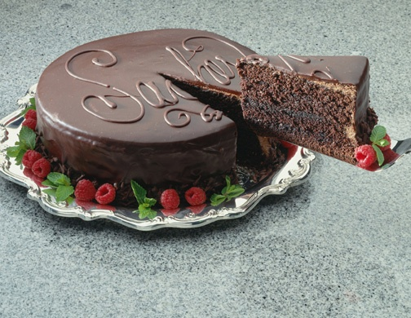
Chocolate cake

Slide 159




Bahan-bahan atau benda yang sebenarnya
Notes:
Even in exactly the right proportions, it is much preferable to eat a chocolate cake than to eat the ingredients separately. It is awfully hard to imagine what a chocolate cake tastes like from the butter, vinegar, flour, egg, etc.
You need everything combined and then it needs to be baked. Raw dough is enjoyed by some, but not the intention of the baker.
Doug Blomberg

Slide 160
Contact information
Harold Klassen
Im Käppele 8
79400 Kandern
Germany
hklassen@janzteam.com
www.transformingteachers.org
+49 (7626) 916077

